Slide 1




Slide 2
NXT9_GIZ2_ERP4_G1
Cash Management Operations and Reporting
Team Members:
Amr Abd Elmonem Ibrahim
Mohamed Osama Mohamed
Abdelrahman Abdelatti Manzor
Moataz Emad Eldin Hassan
Our Instructor: Eng / Mohamed Sobhy

Slide 3
Project Overview
To optimize cash management operations and reporting using Oracle EBS, enhancing financial accuracy, speeding up processes, and providing insights to support informed decision-making.

Slide 4
Scope of Work
Create and configure bank account.
Cash clearing.
Bank reconciliation.
Cash forecasting.

Slide 5

Create and configure bank accounts
Presented By : Amr Abd El-Monem Ibrahim Elmohdy

Slide 6

Steps to define a new bank account
Define bank name.
Define bank branch.
Define bank account.

Slide 7
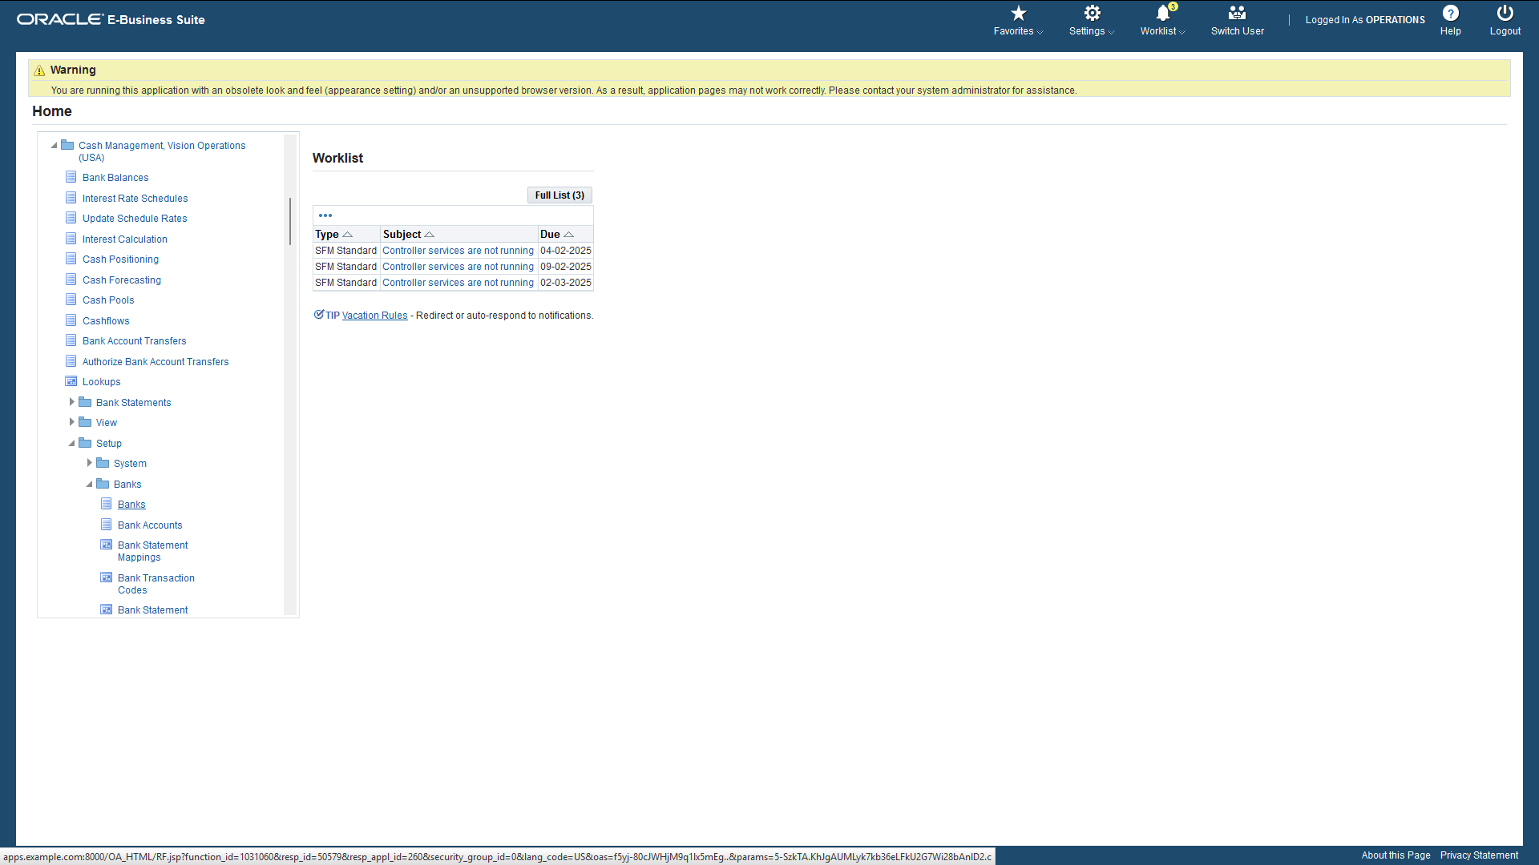

Slide 8
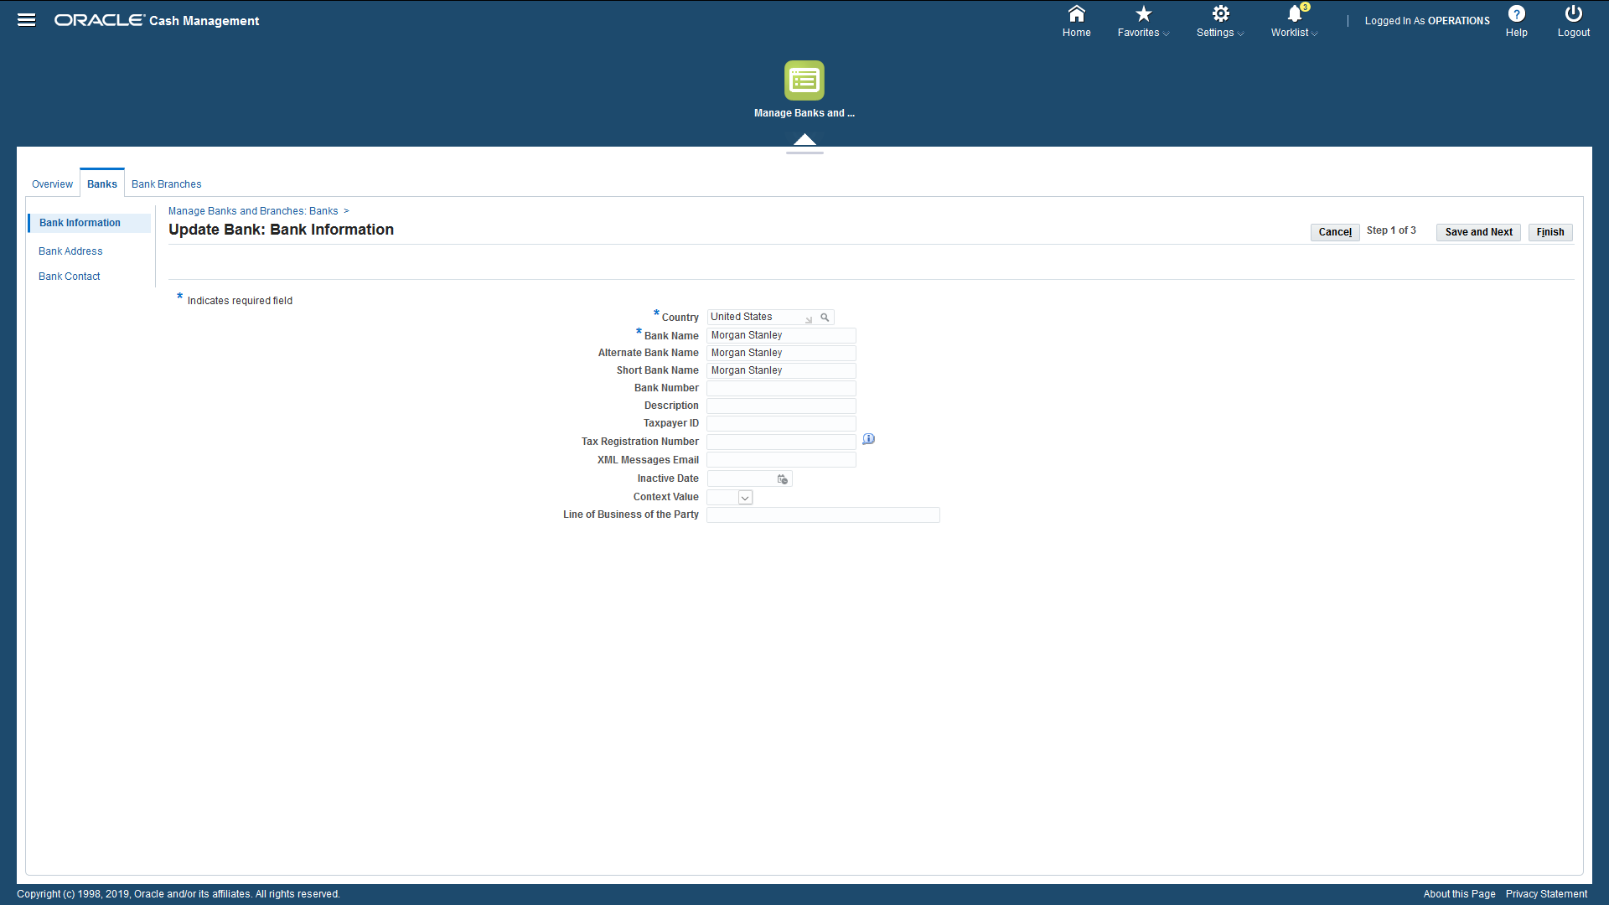

Slide 9
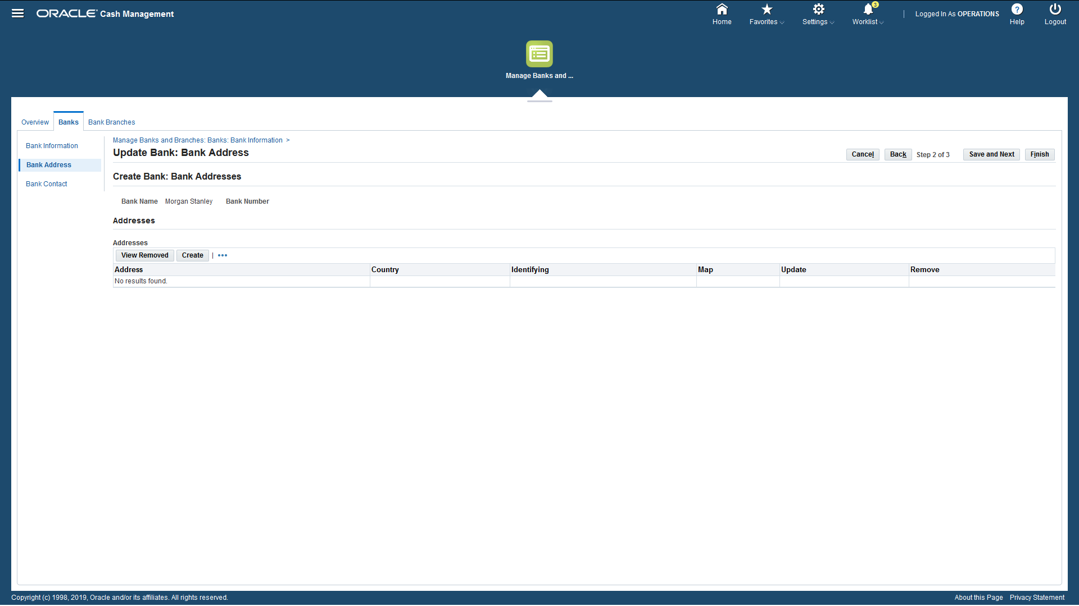

Slide 10
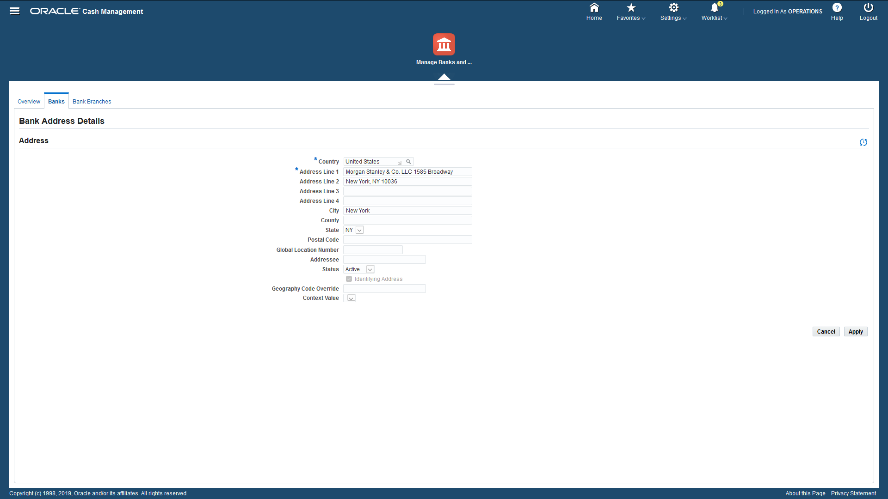

Slide 11
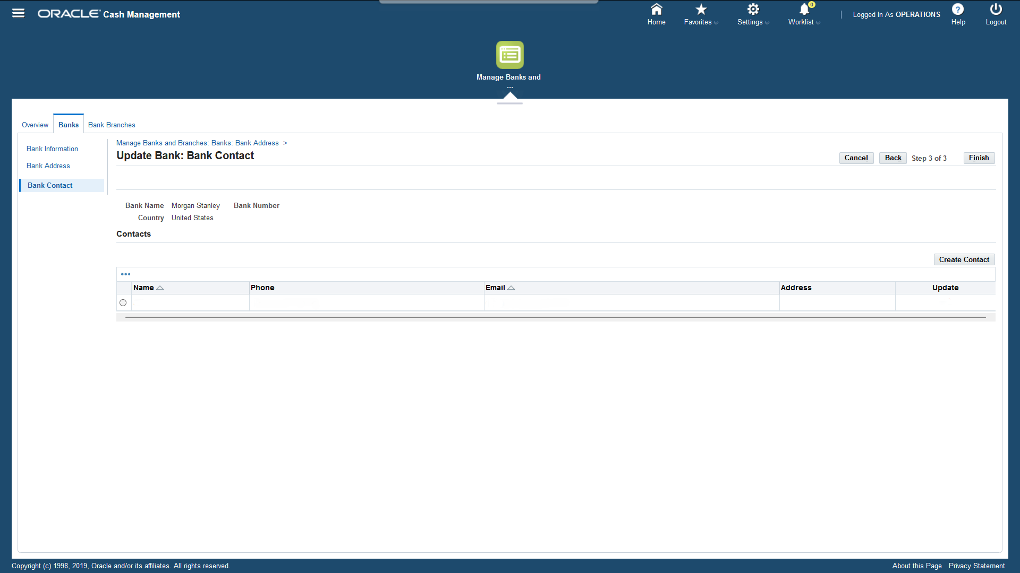

Slide 12
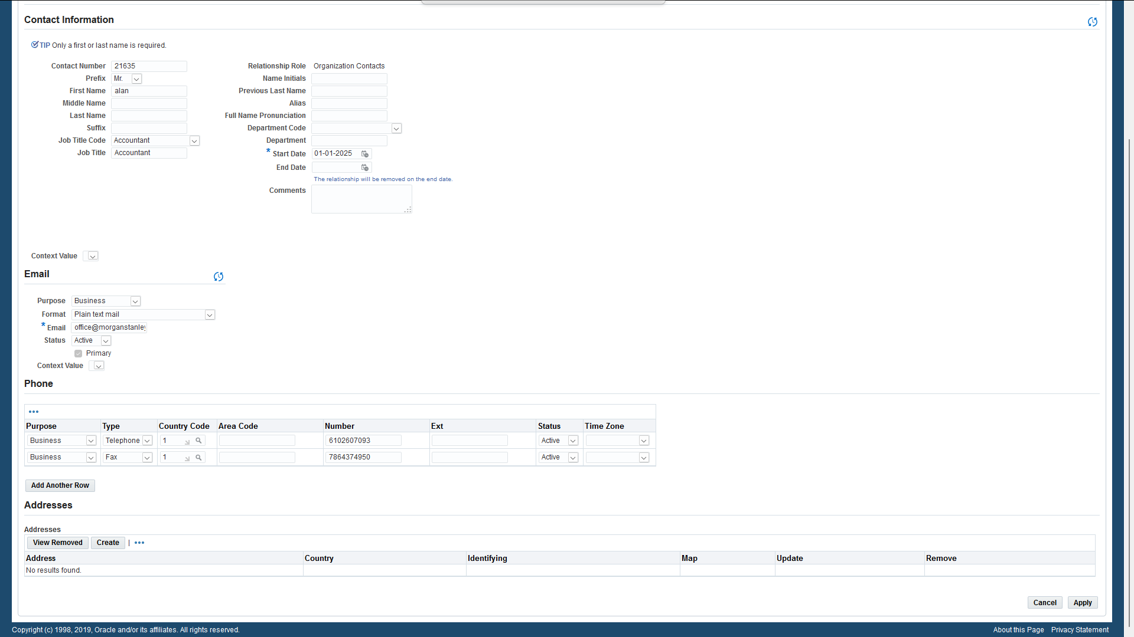

Slide 13
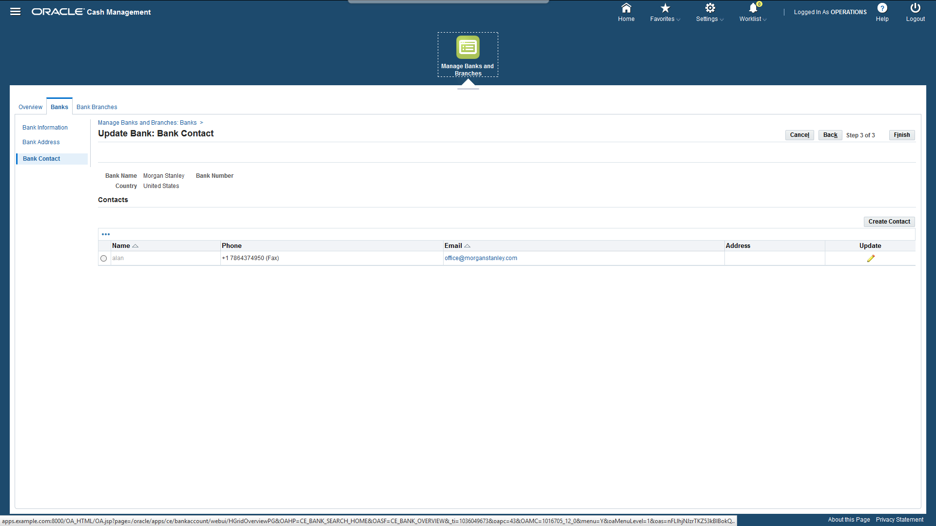

Slide 14
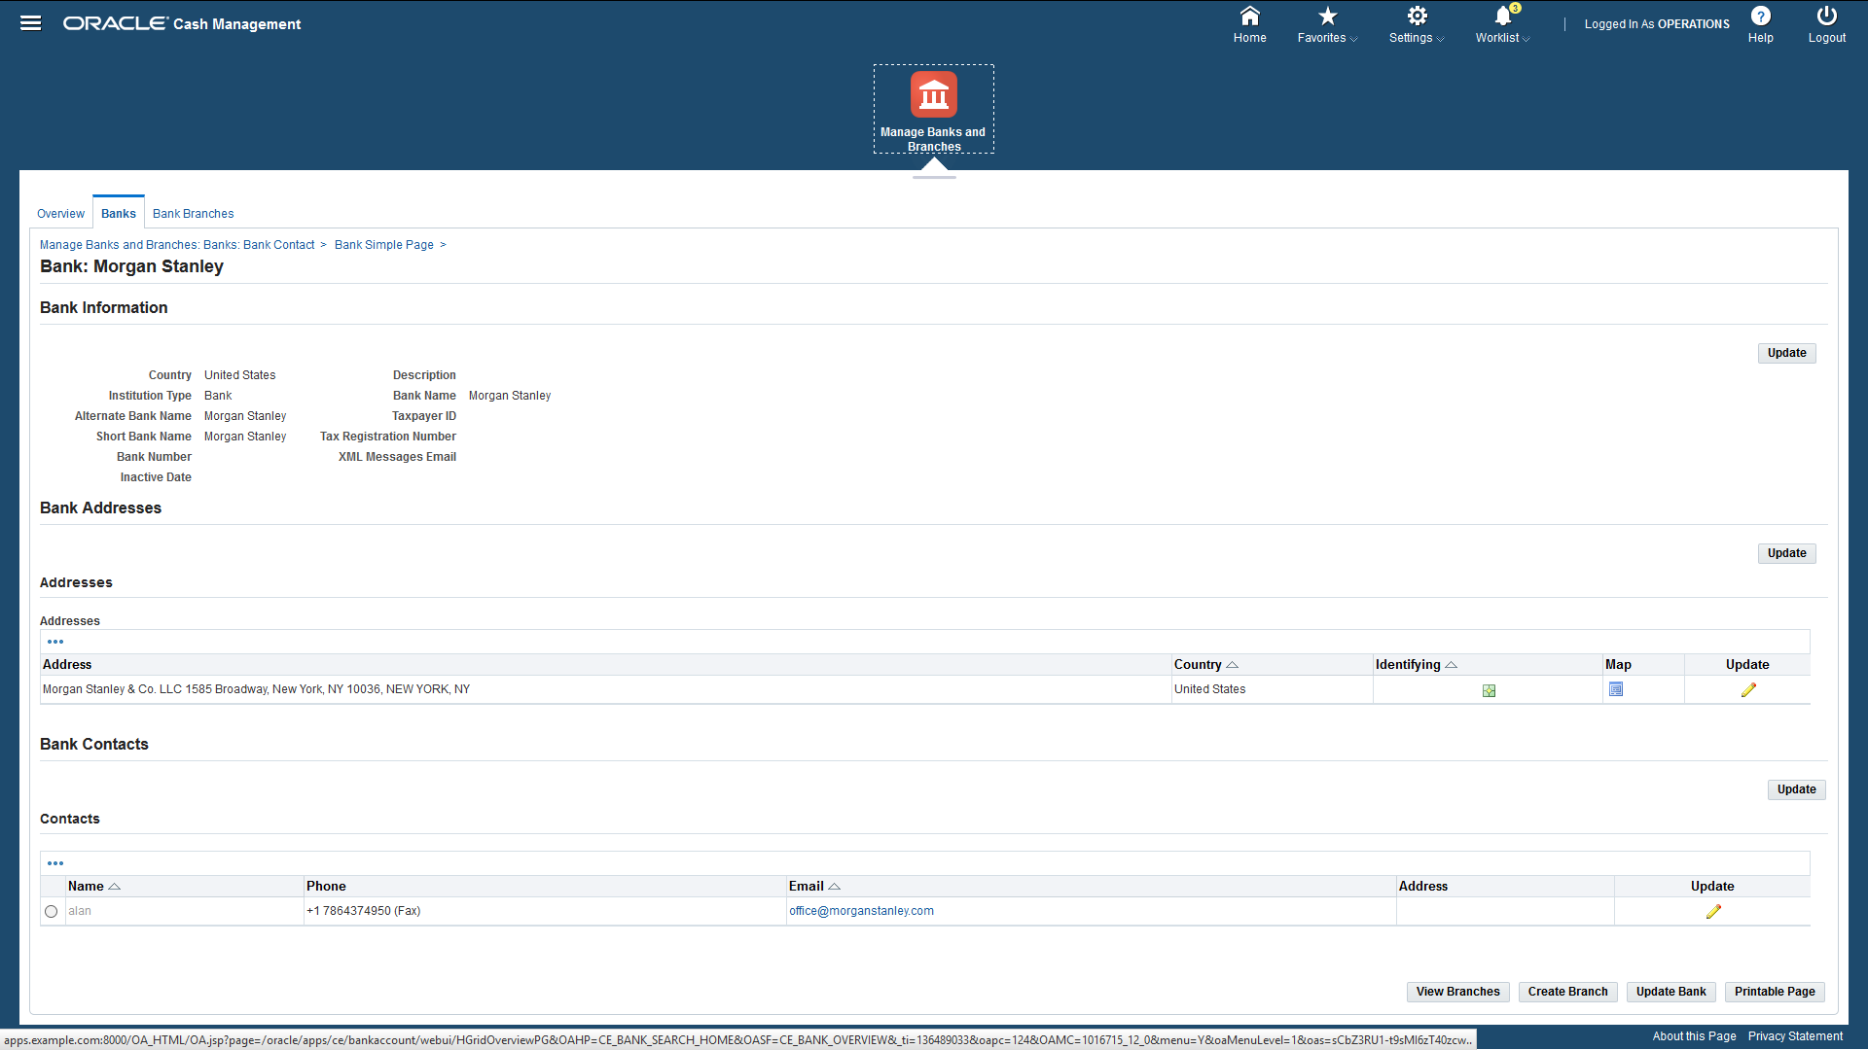

Slide 15
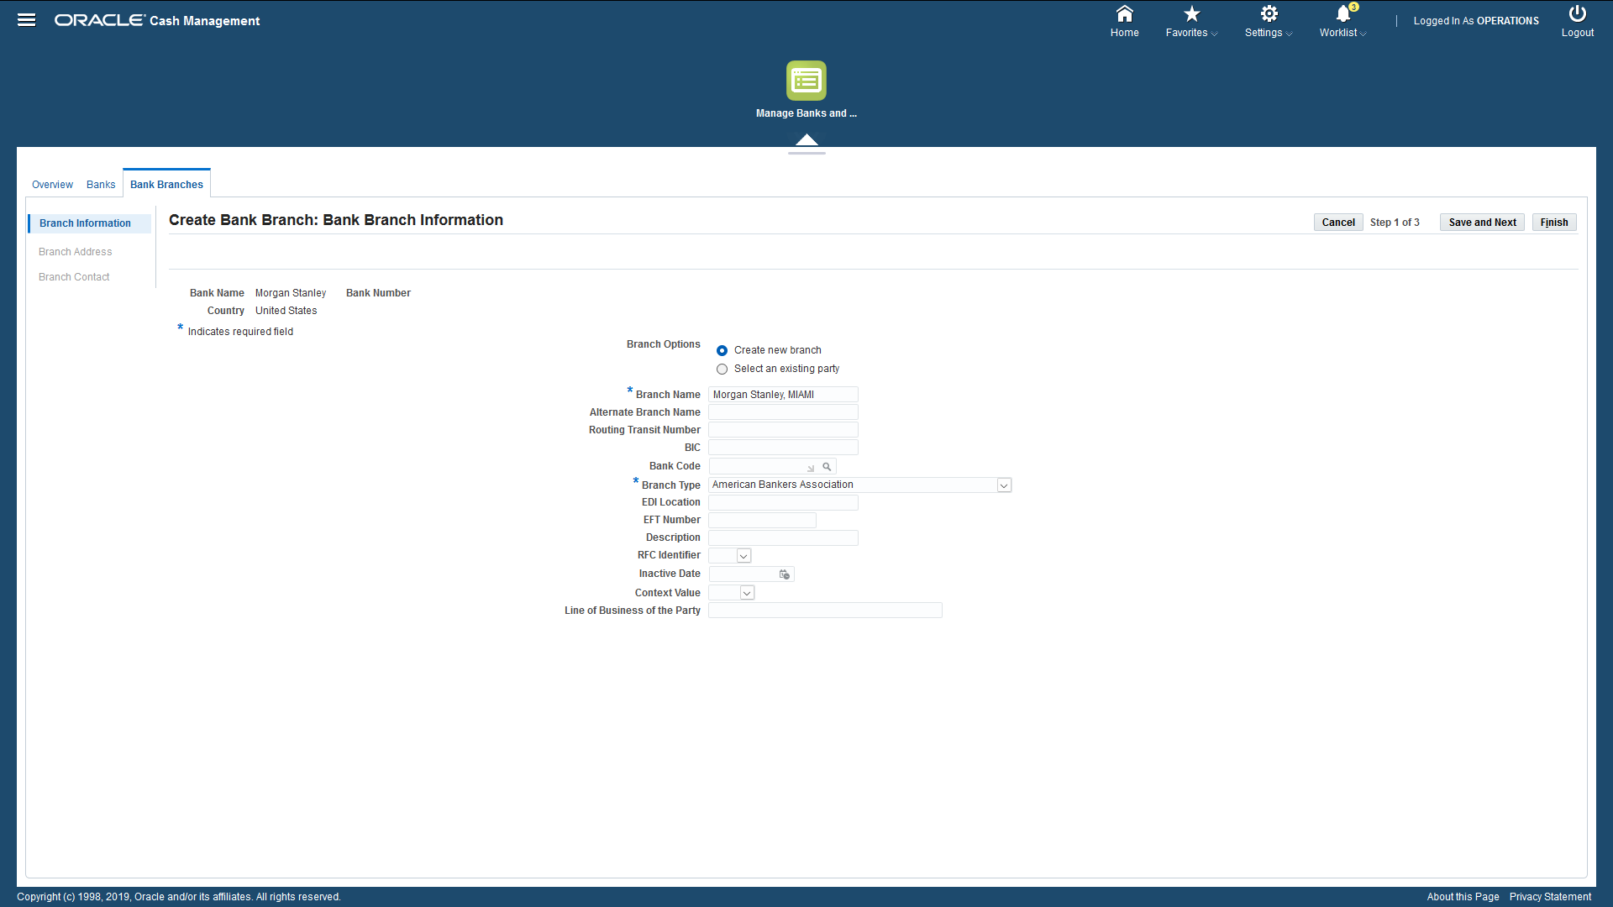

Slide 16
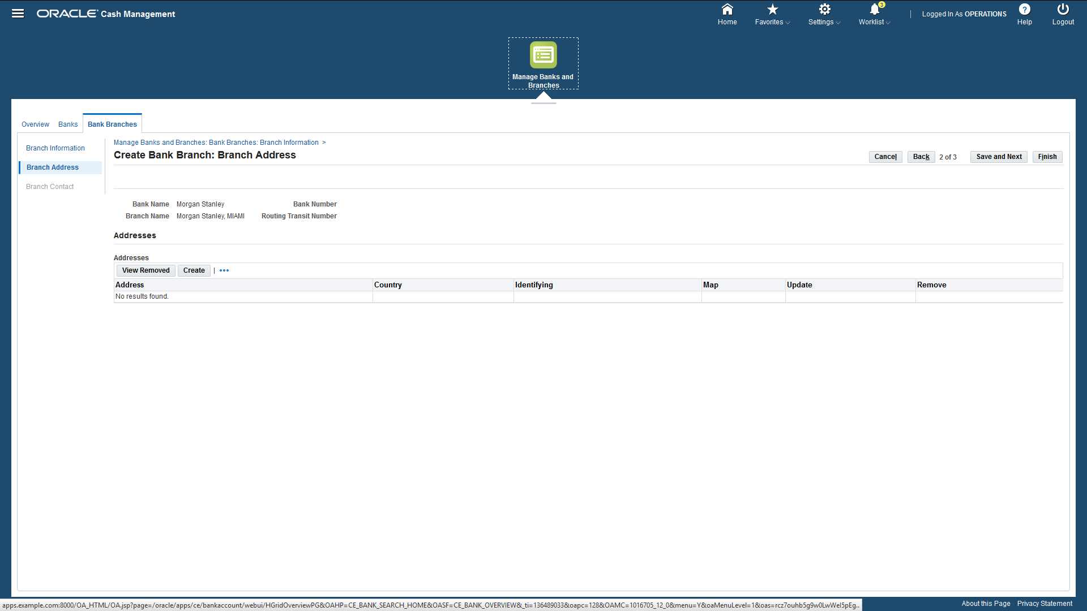

Slide 17
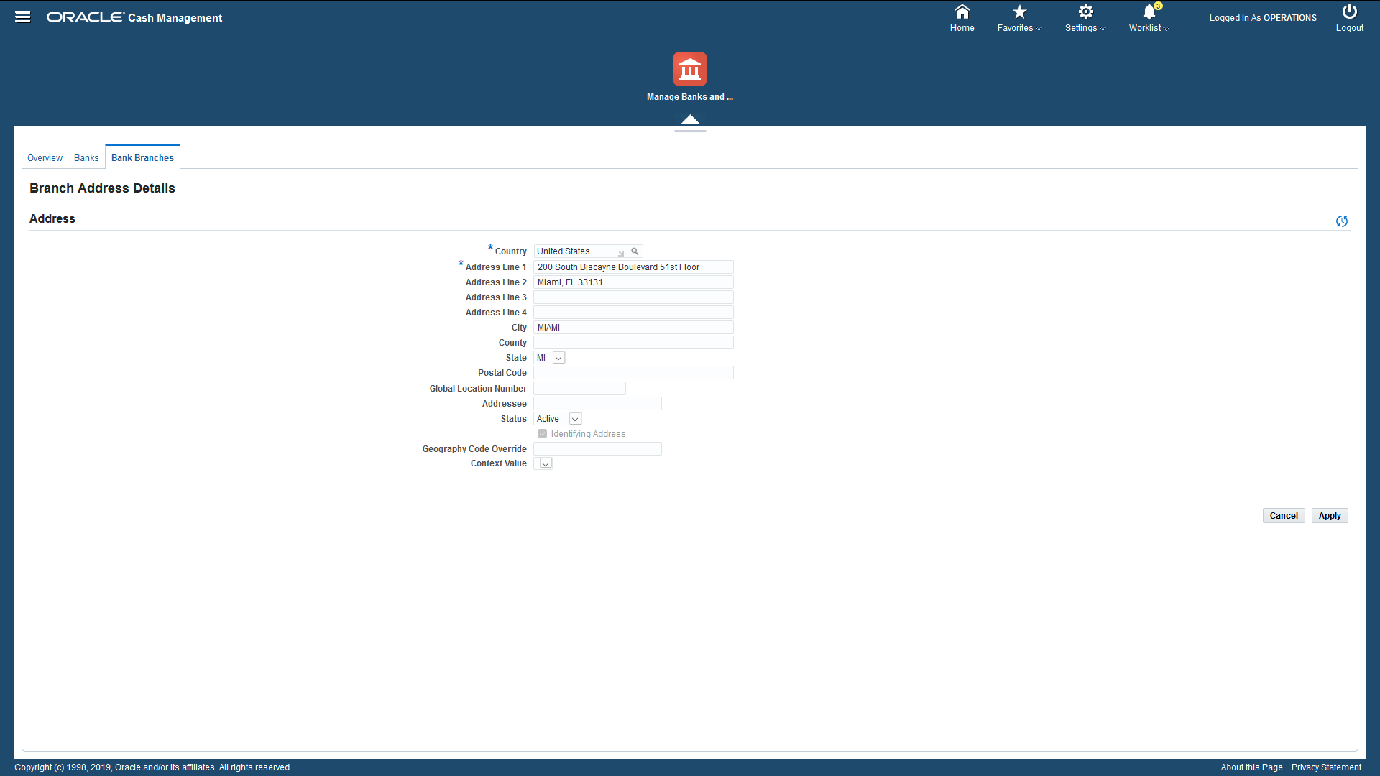

Slide 18
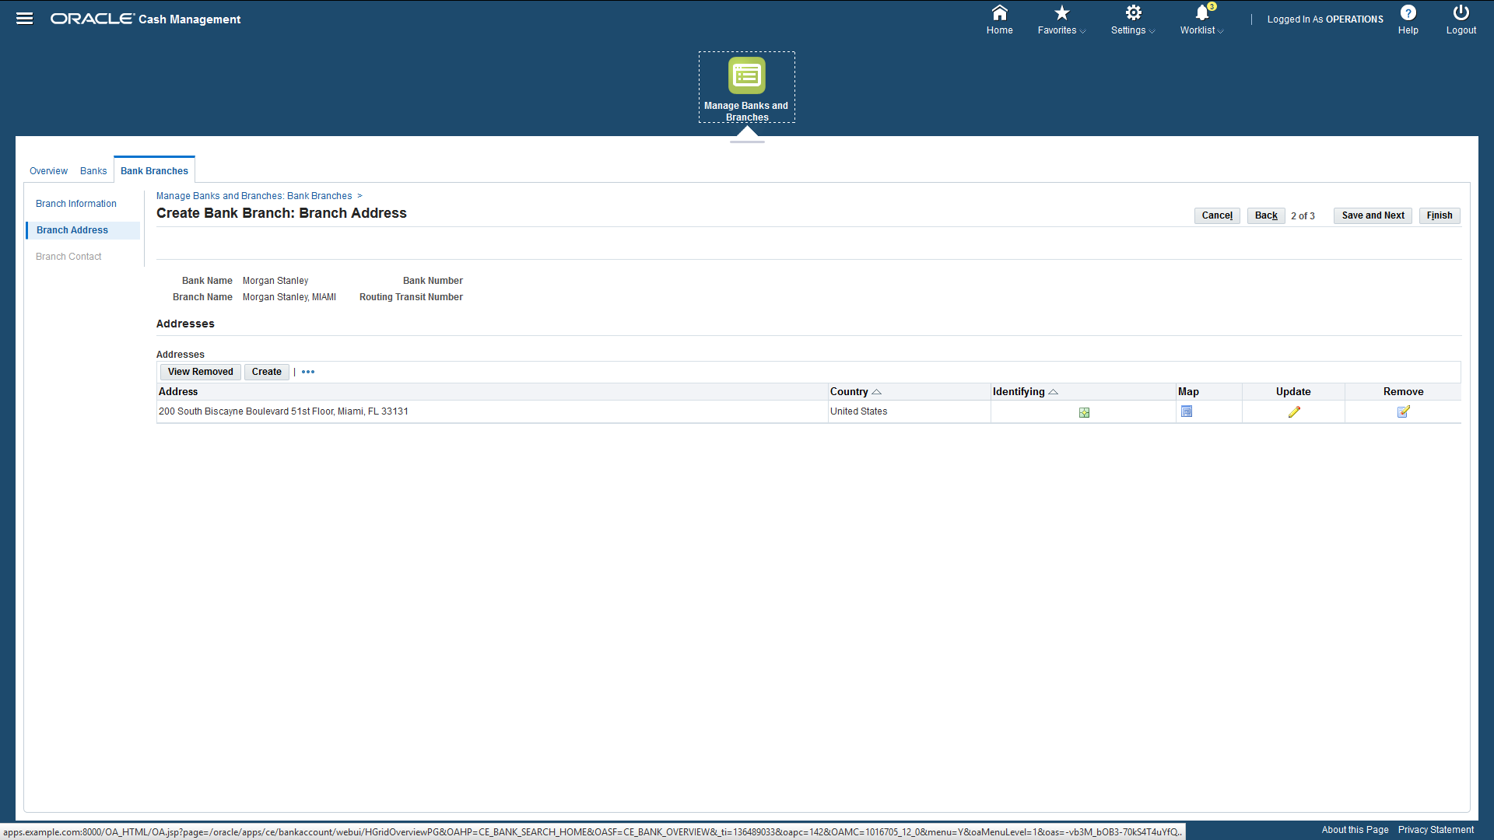

Slide 19
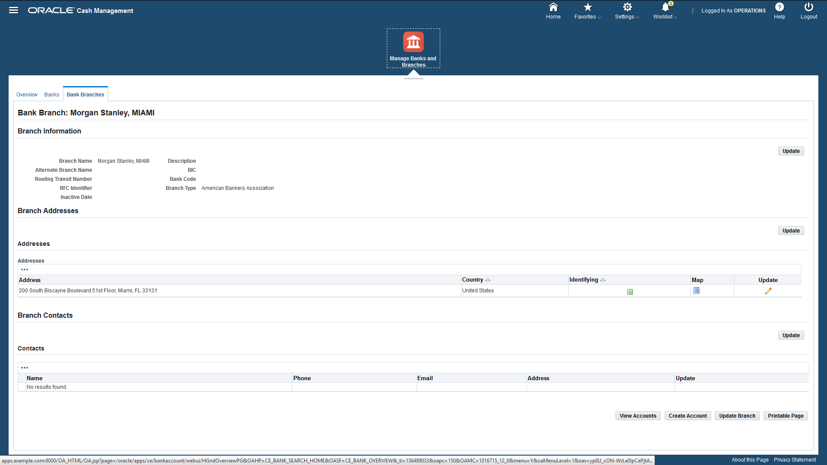

Slide 20
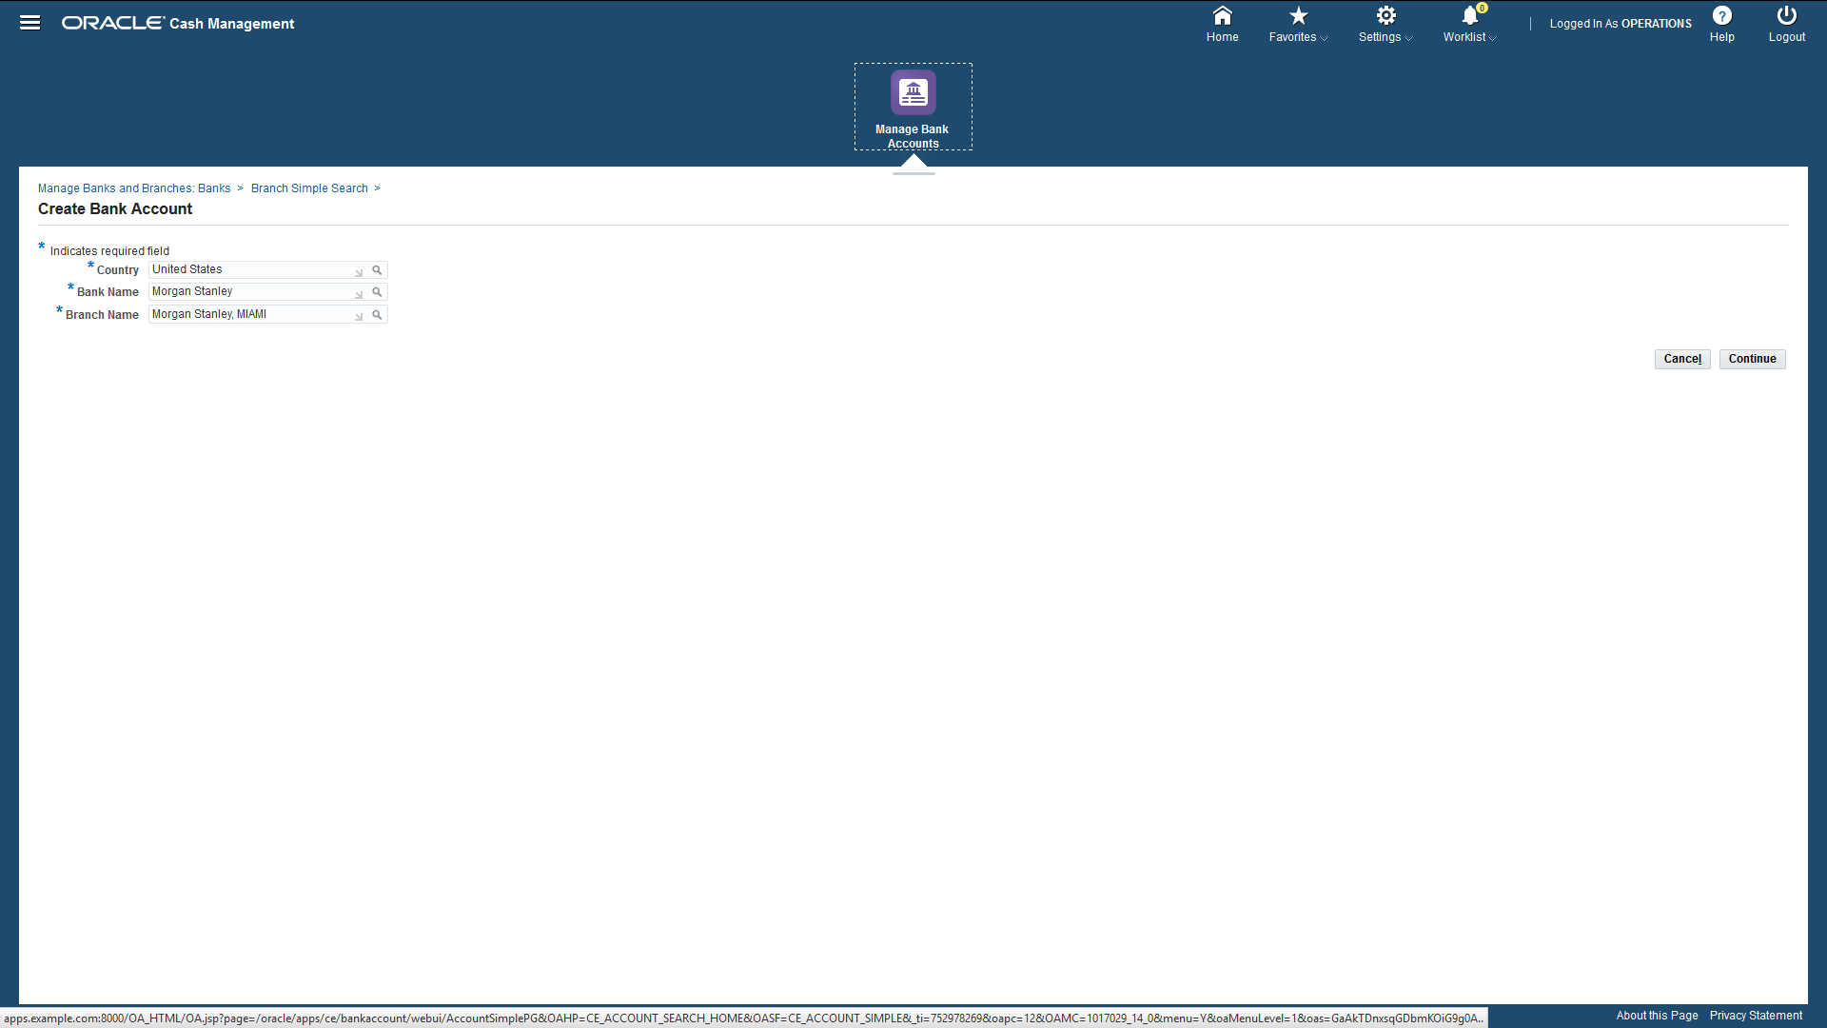

Slide 21
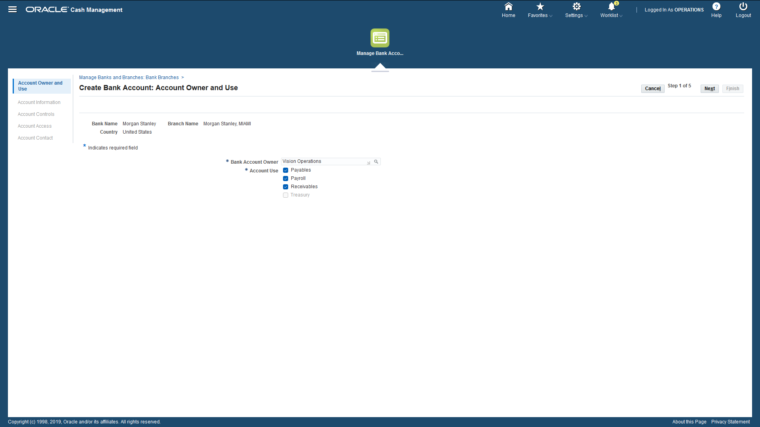

Slide 22
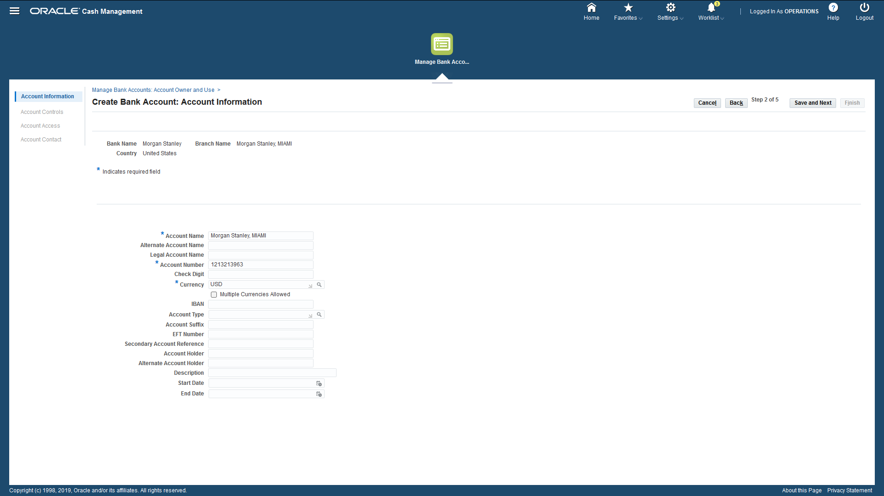

Slide 23
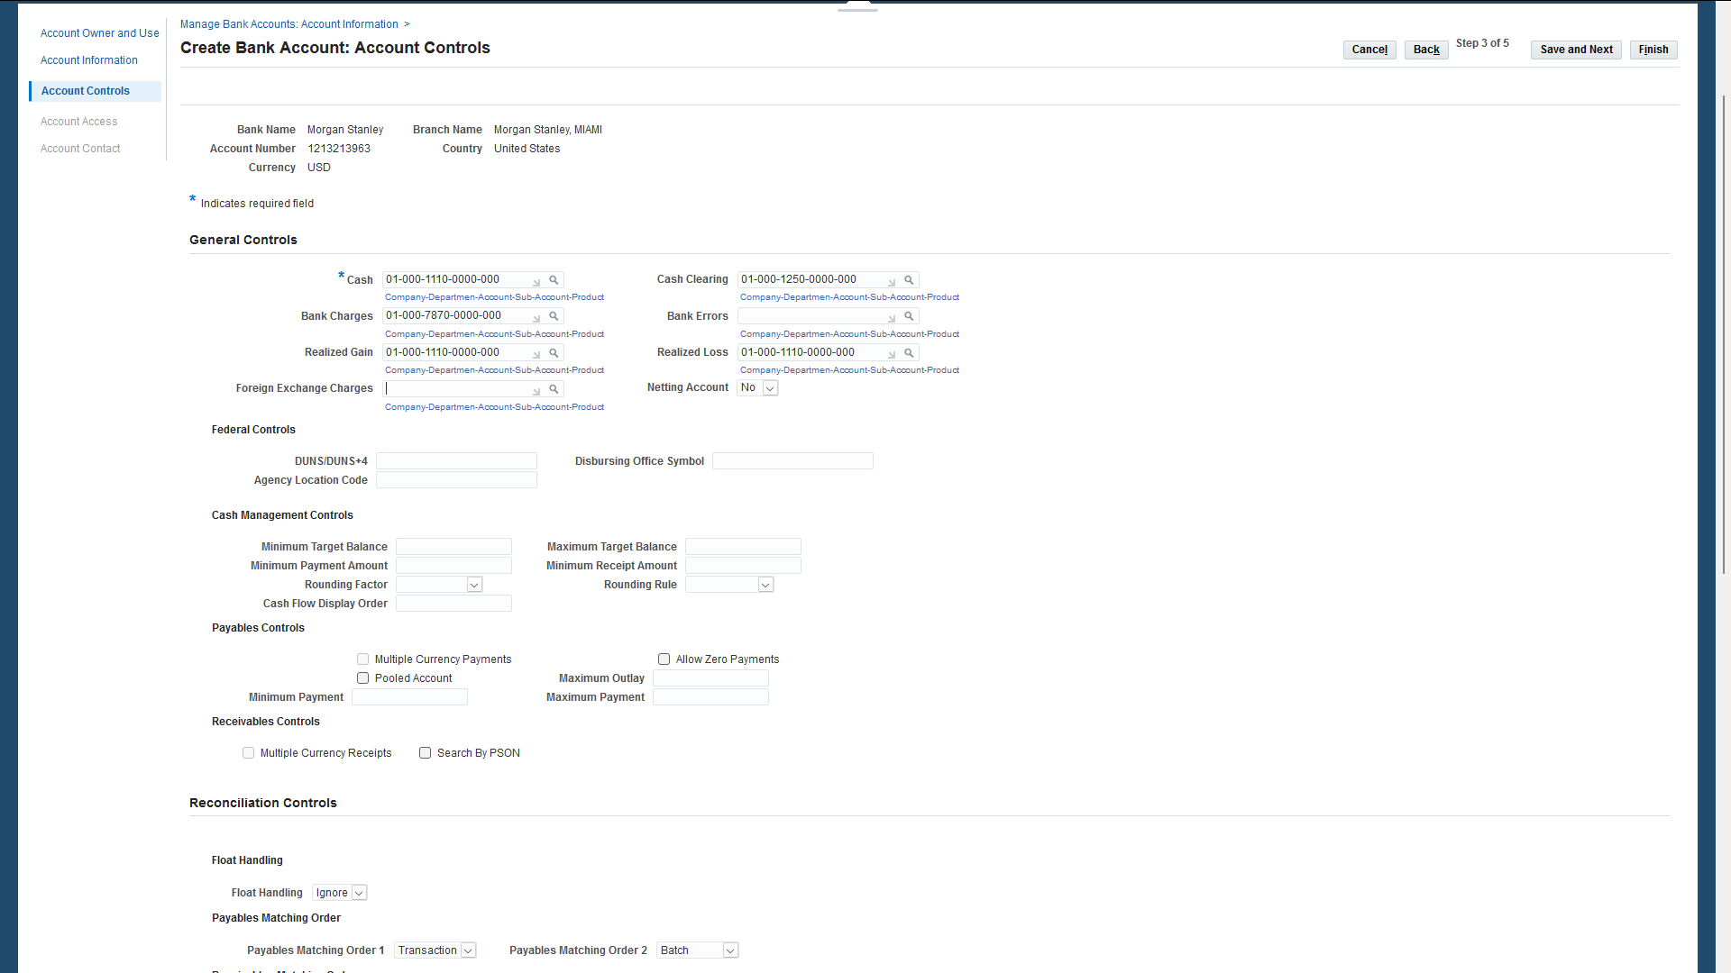

Slide 24
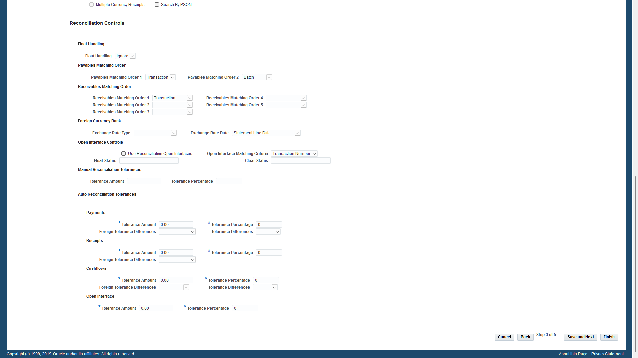

Slide 25
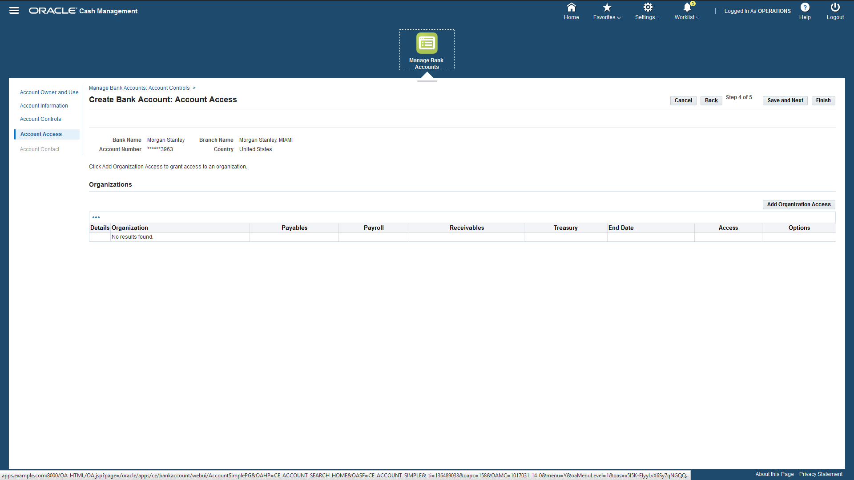

Slide 26
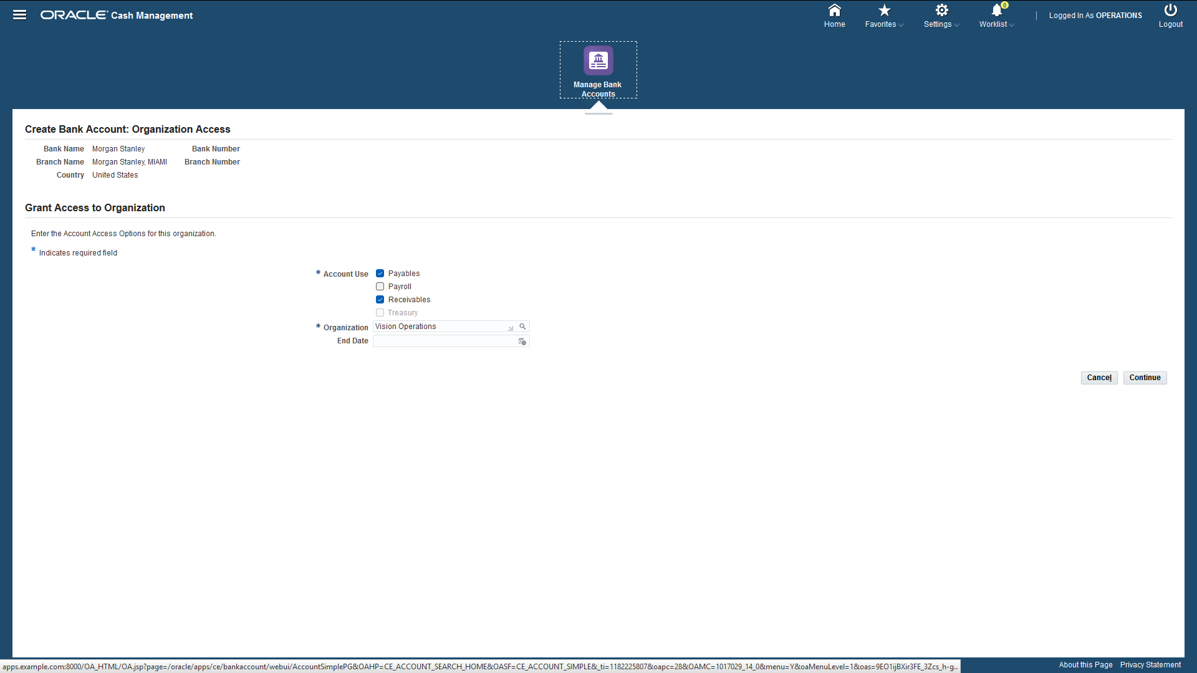

Slide 27
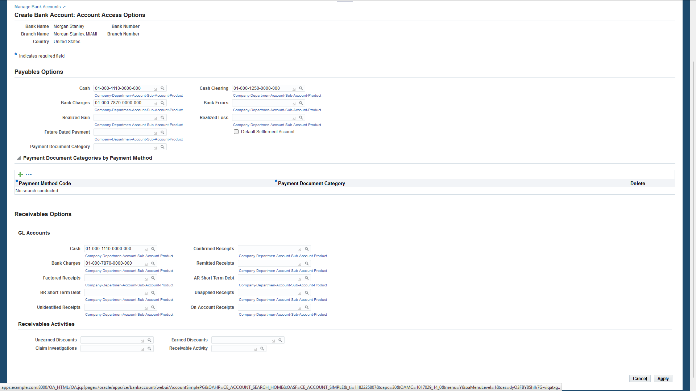

Slide 28
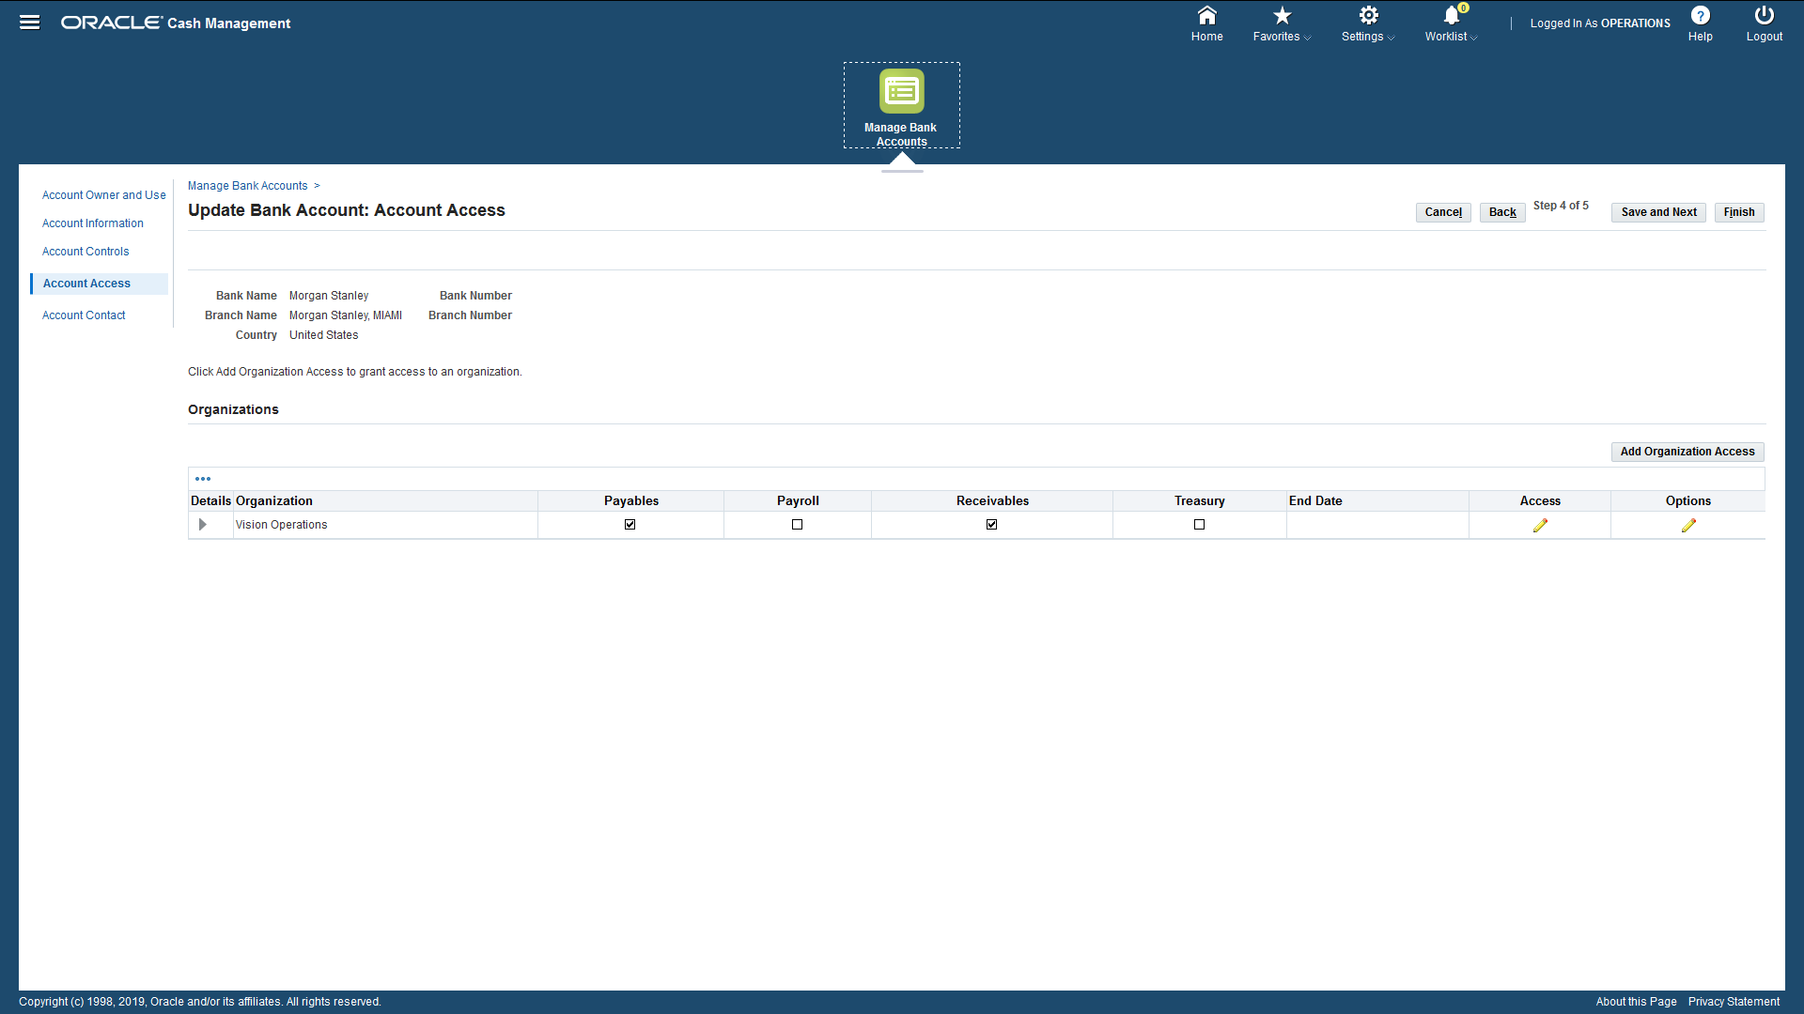

Slide 29
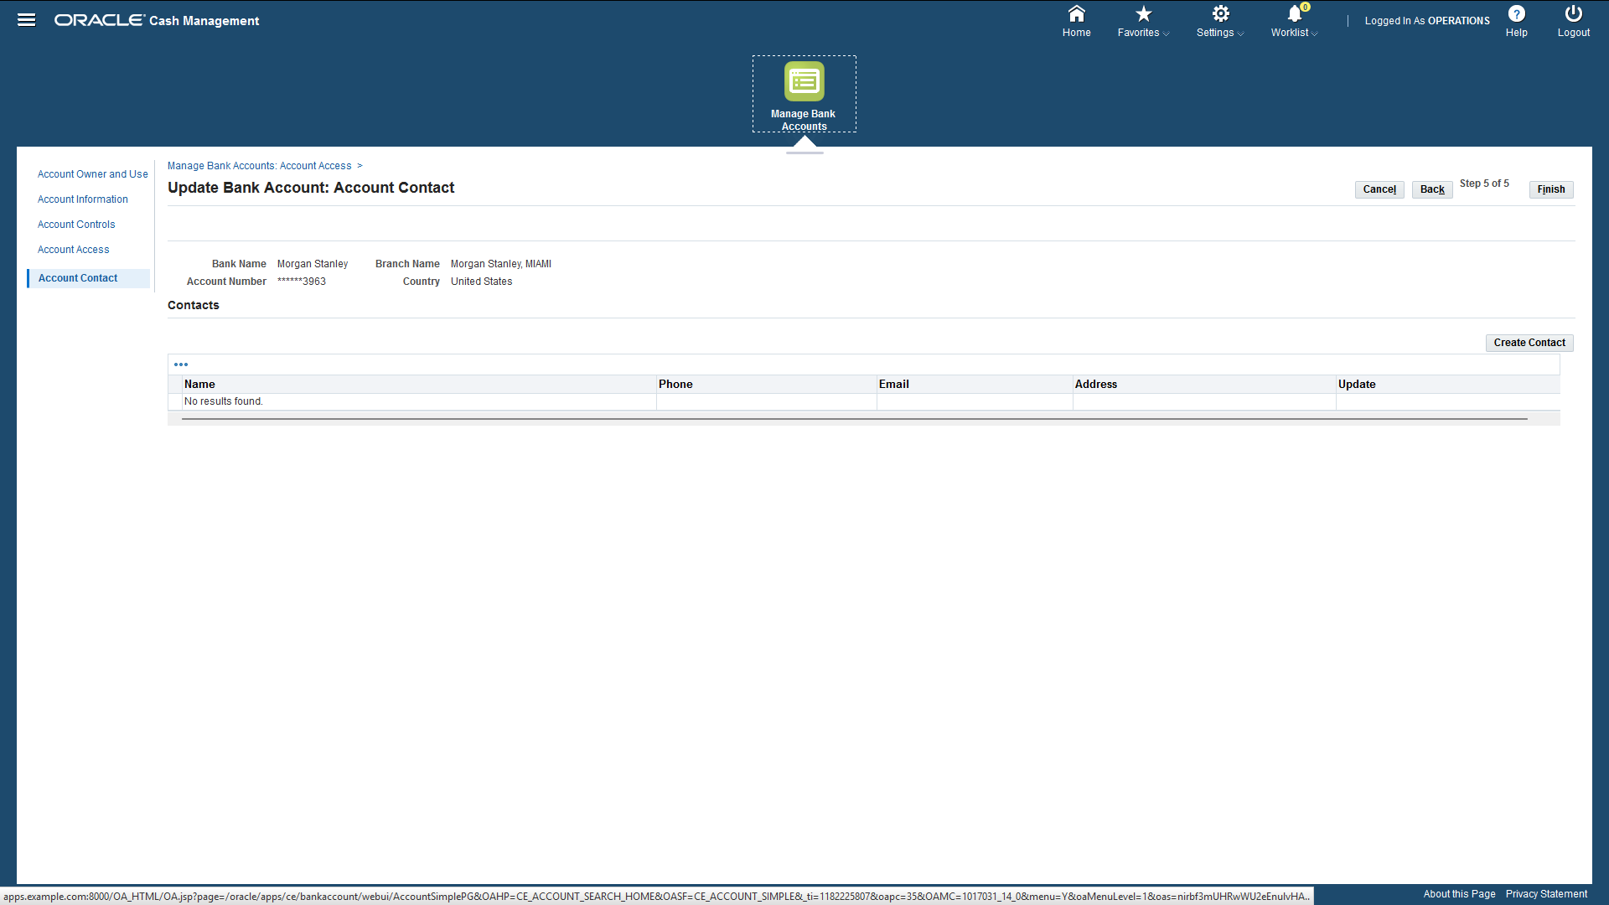

Slide 30
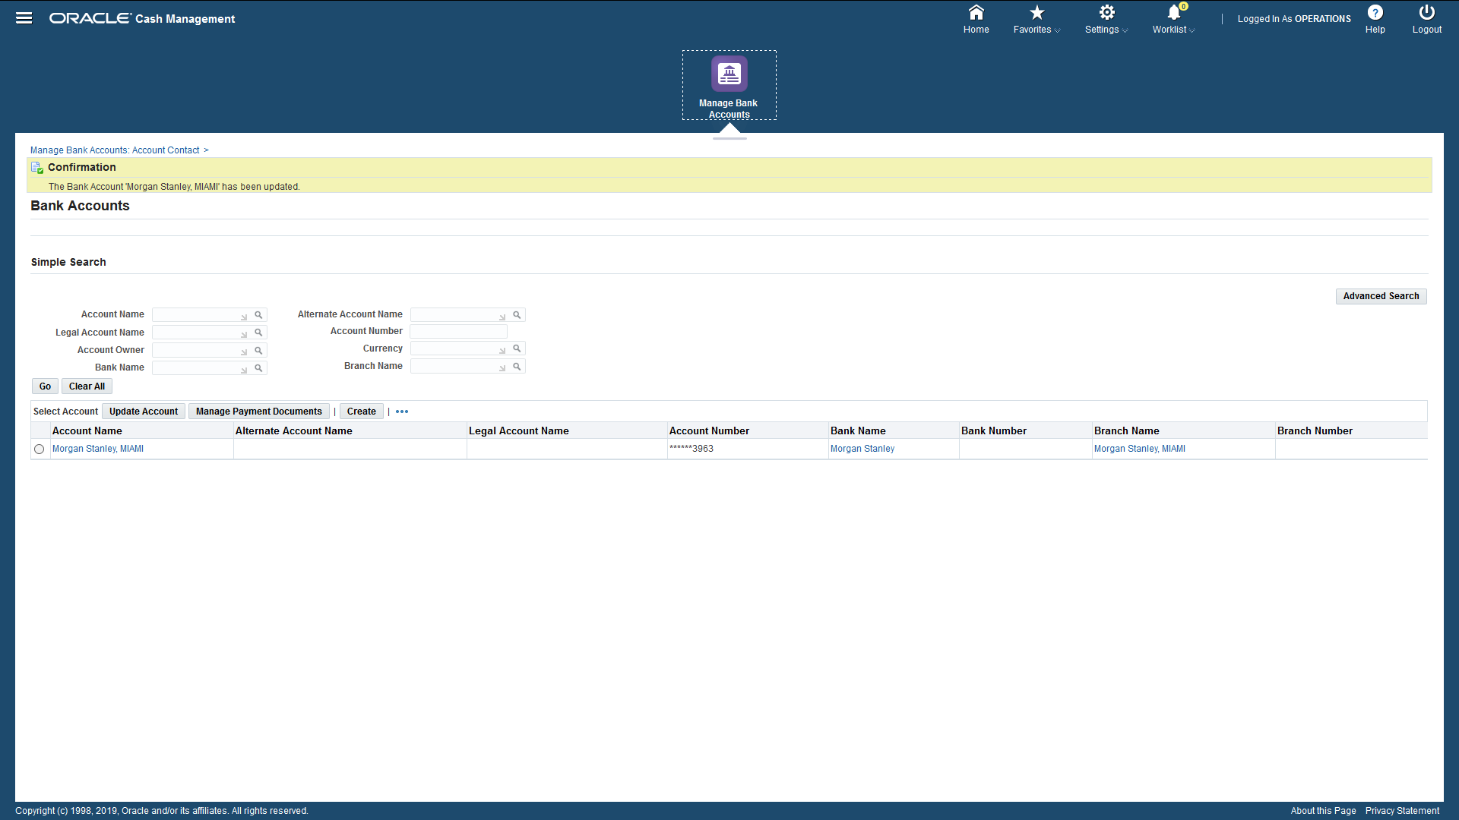

Slide 31
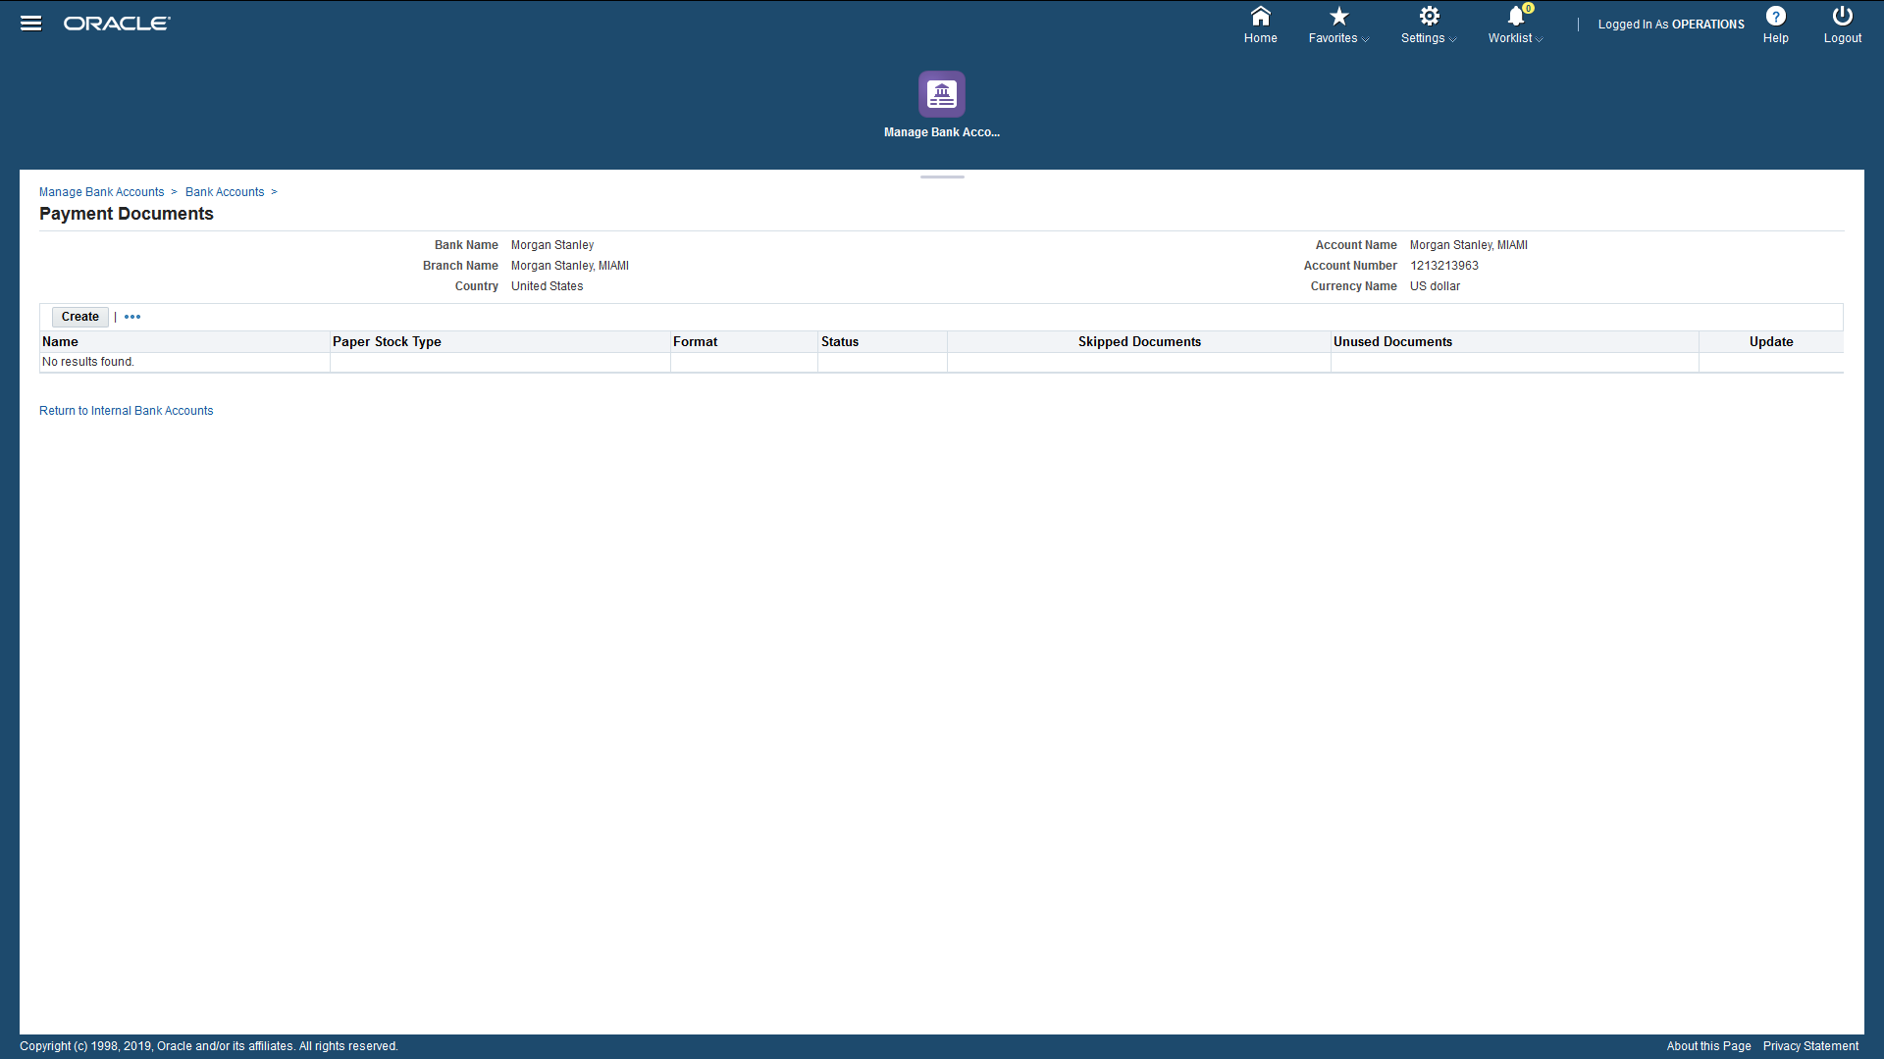

Slide 32
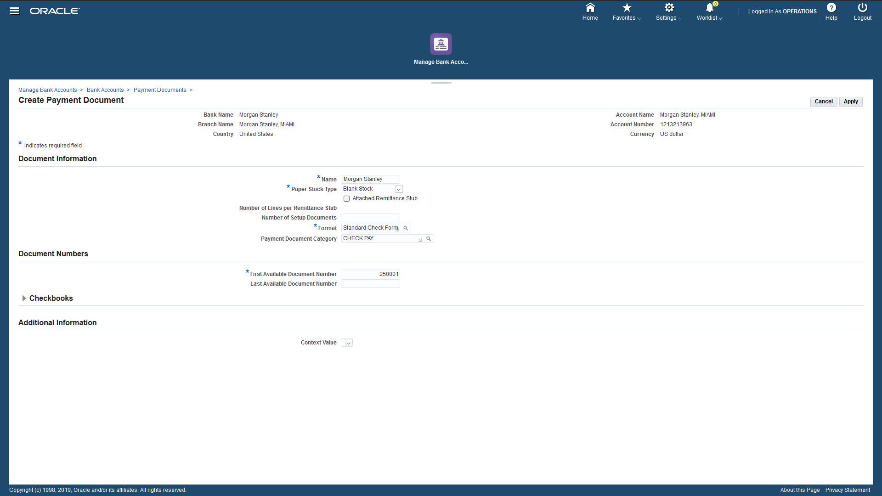

Slide 33
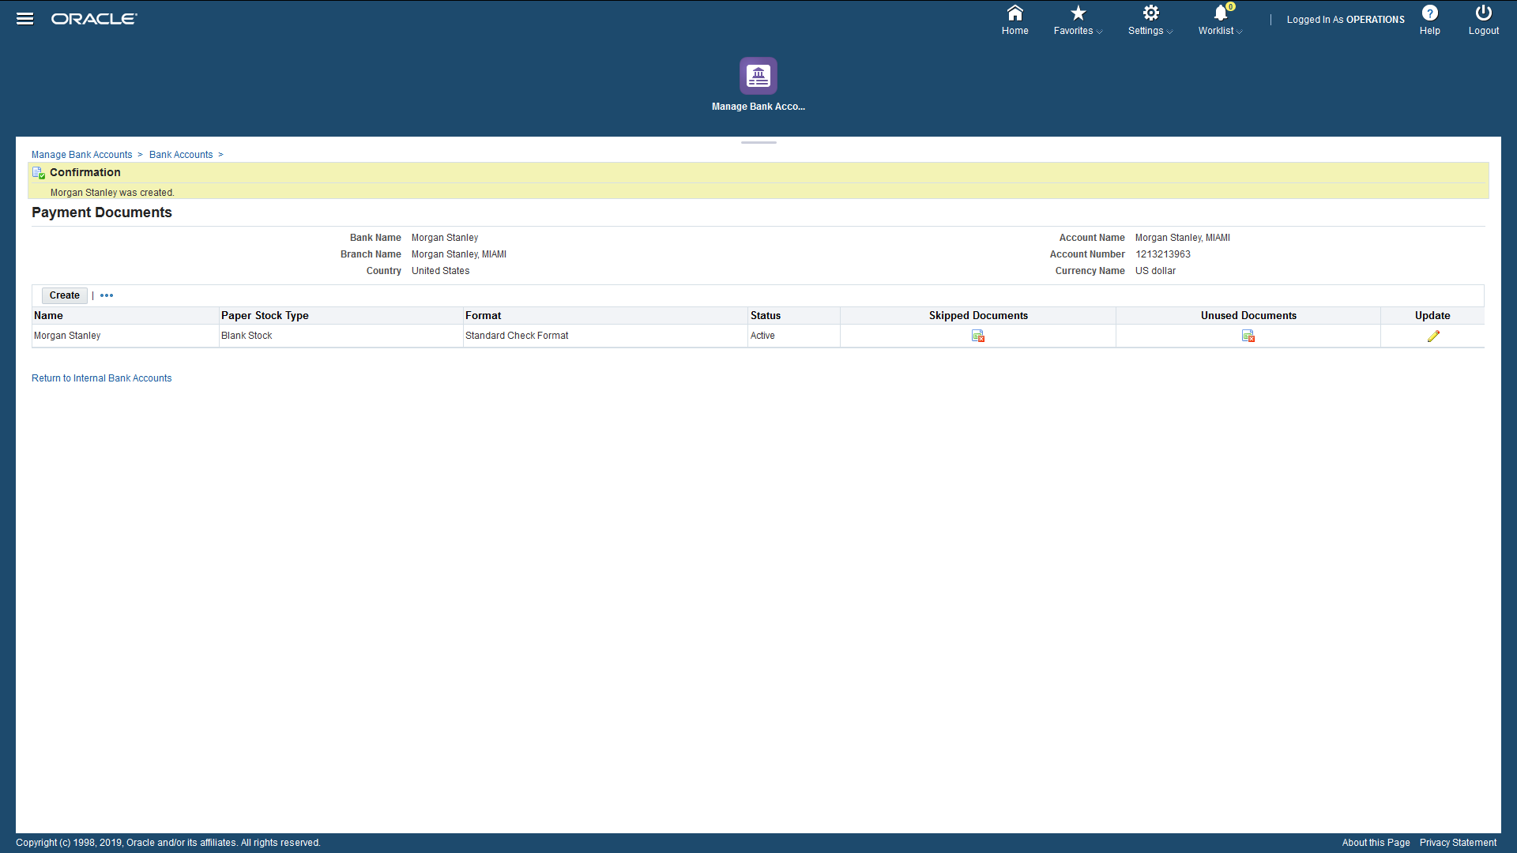

Slide 34

Cash Clearing
(Manual Clearing)
Presented By : Mohamed Osama Mohamed

Slide 35
Why we use manual clearing?
we use manual clearing for transactions of receipts or payments to match amount of receipts or payments with the available balance in the bank account, and to be able to review each receipt and payment by clearing them individually.

Slide 36
Conditions of clearing?
To make Clearing for receipt its status should be remitted.
To make Clearing for payment of invoice status should be negotiable.

Slide 37
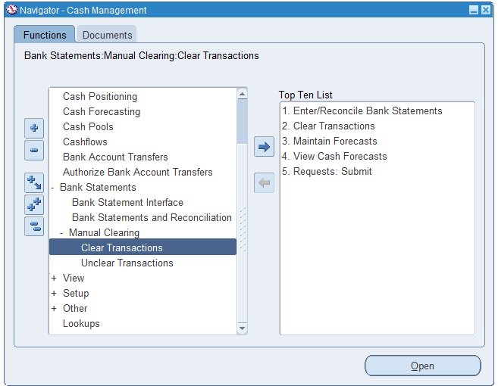
Steps of clearing transaction
1-Choose Bank statements from cash management icon.
2-Choose from Bank statements drop down menu manual clearing.
3-Choose from manual clearing drop down menu Clear Transactions.

Slide 38
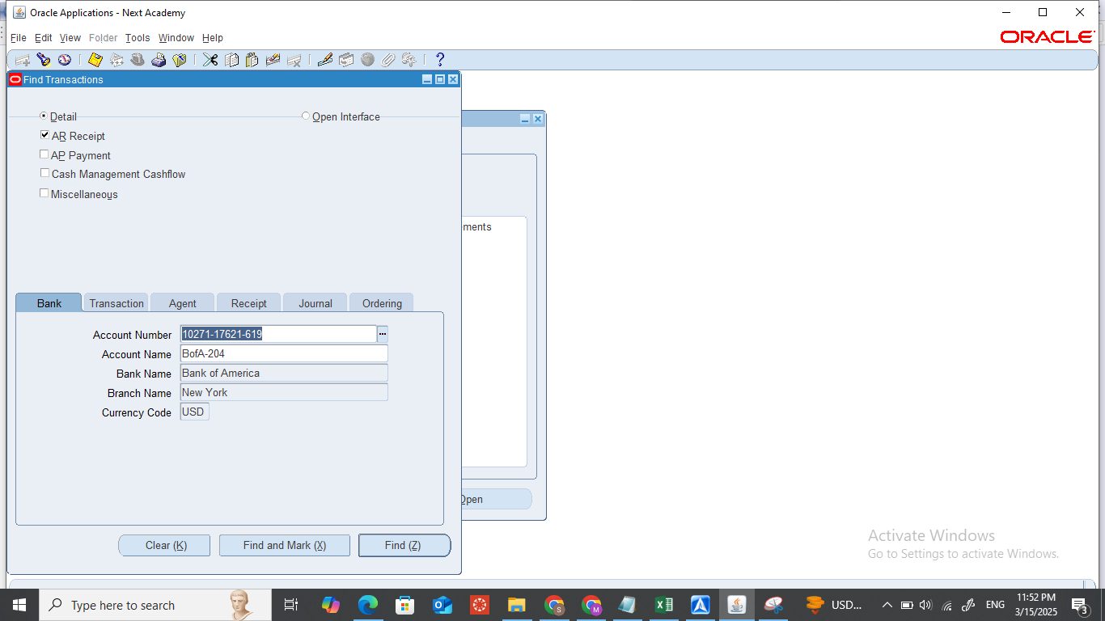
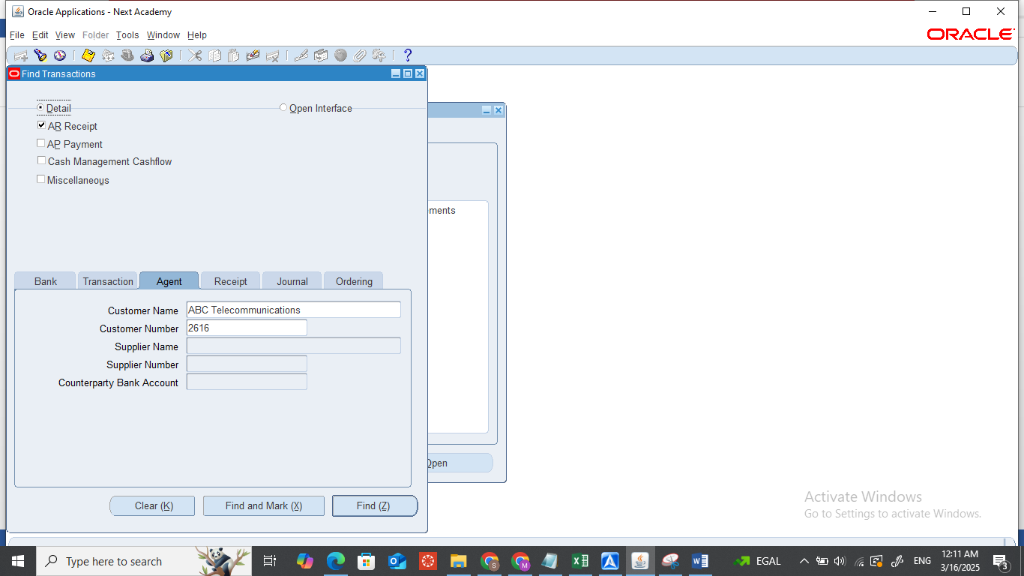
4- Then specify the type of transaction I want to clear if it receipt or payment.
5- Choose Bank name, Account number, Transaction number, agent name, receipt or payment number then search.

Slide 39
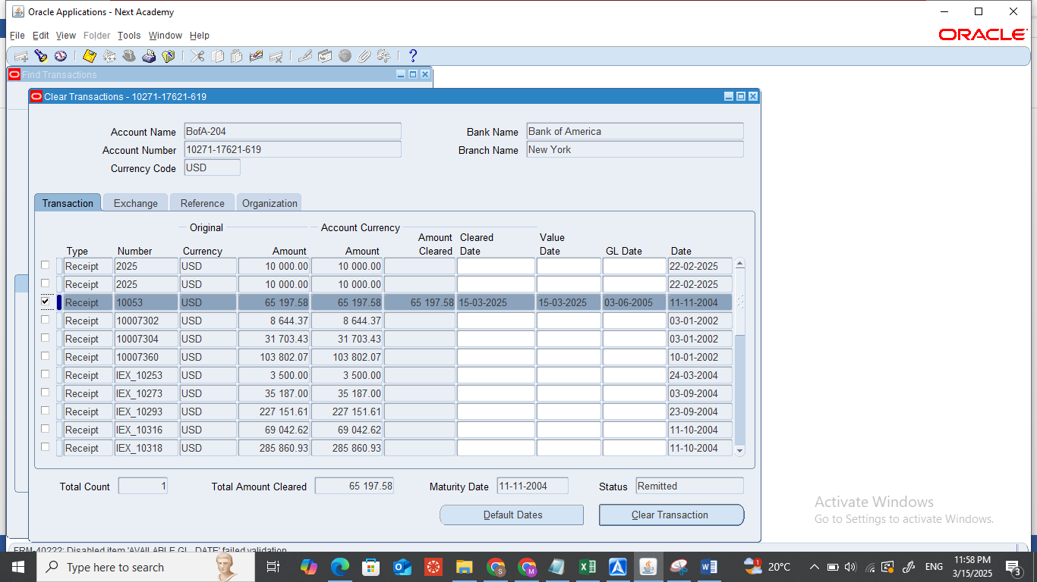
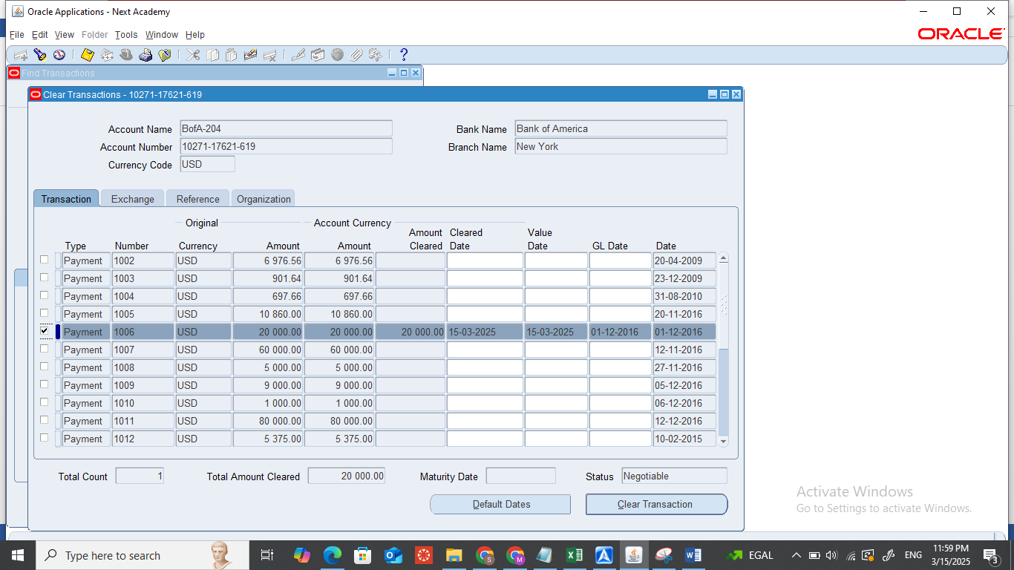
6-Ensure that the status of receipt is remitted and the status of payment is negotiable.
7-Check the check box for receipts or payment (Choose it).
8-Press on the clear transaction button.

Slide 40

Can we reverse clearing transaction?

Slide 41

Yes, by Unclear Transaction Icon

Slide 42
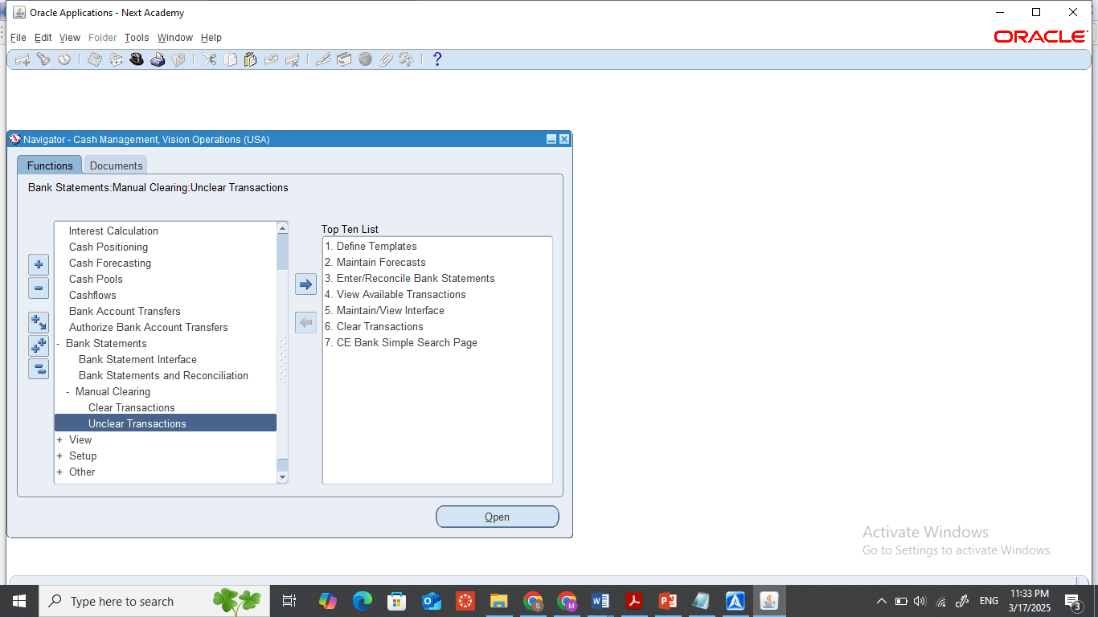
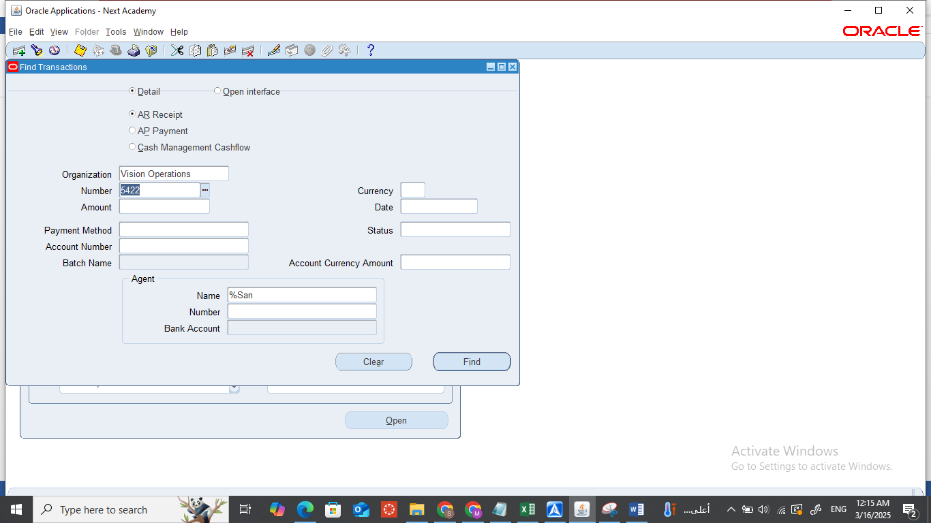
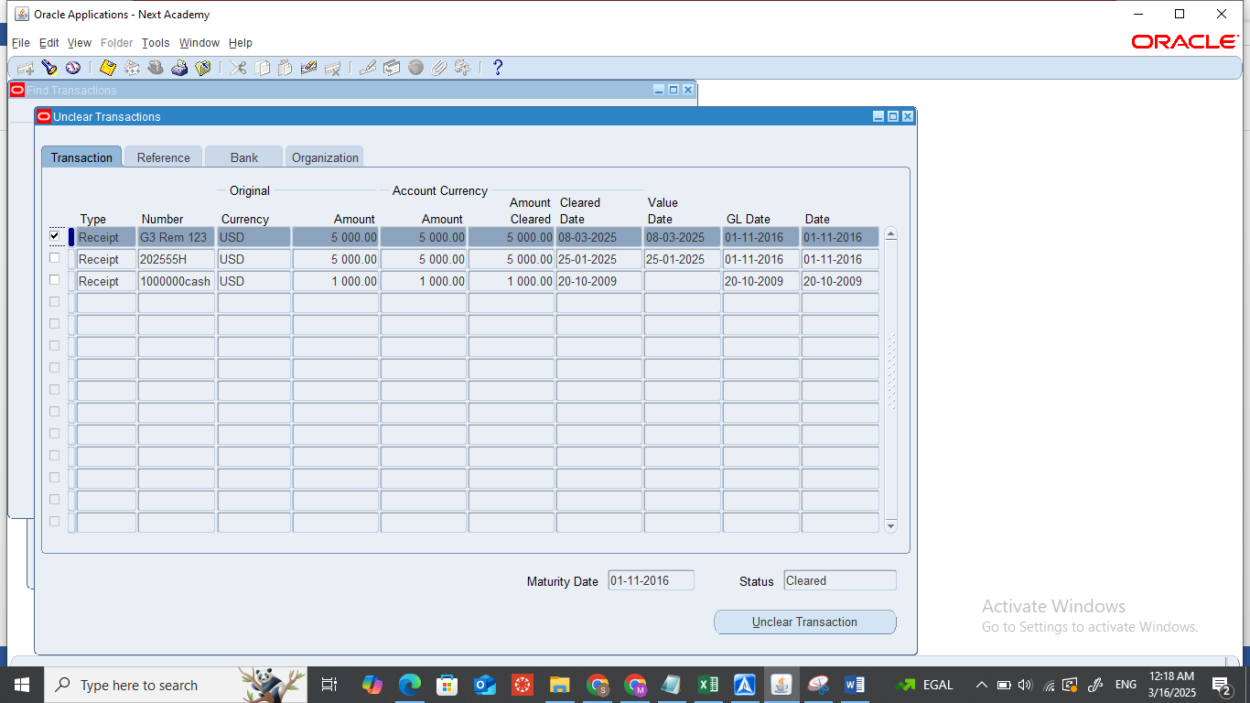
1-Choose Unclear transaction from the manual clearing drop-down menu.
2-Choose if I want unclear receipt or payment cleared before.
3-Determine agent name, specific receipt or payment number, or amount.
4-Check the check box of receipt or payment (Choose it)
5-Press on the Unclear transaction button

Slide 43

Bank Reconciliation
Presented By : Abdelrahman Abdelatti Manzor

Slide 44
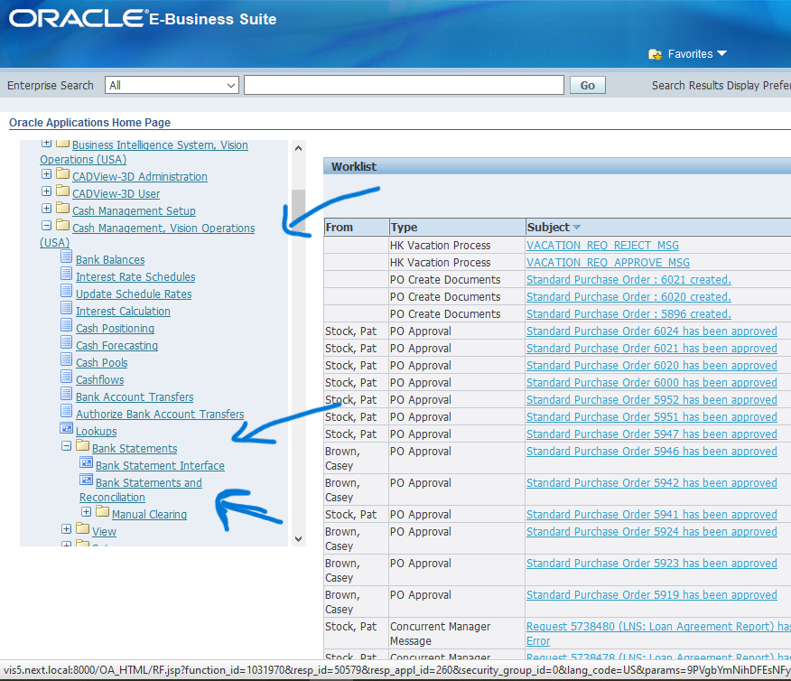
Reconciliation
What is the reconciliation? The process of matching system-recorded cash transactions with bank statements
How to find it in Oracle ERP?
Open the Oracle home page, then choose the Bank statement and reconciliation

Slide 46
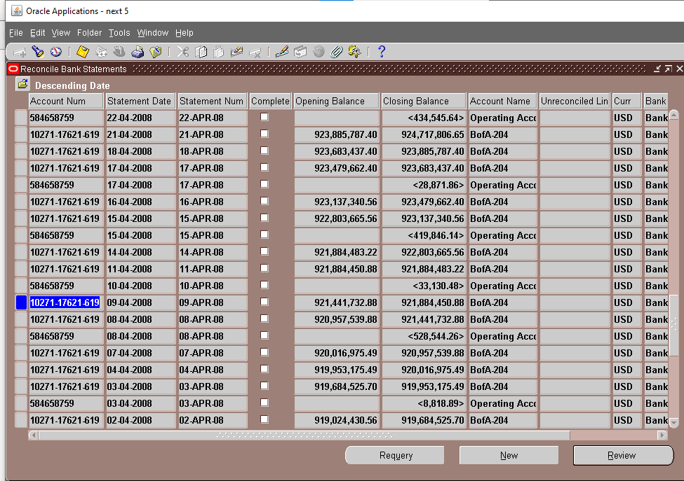
Reconcile bank statement window
Explain page contents
Choose element
Click review button

Slide 48
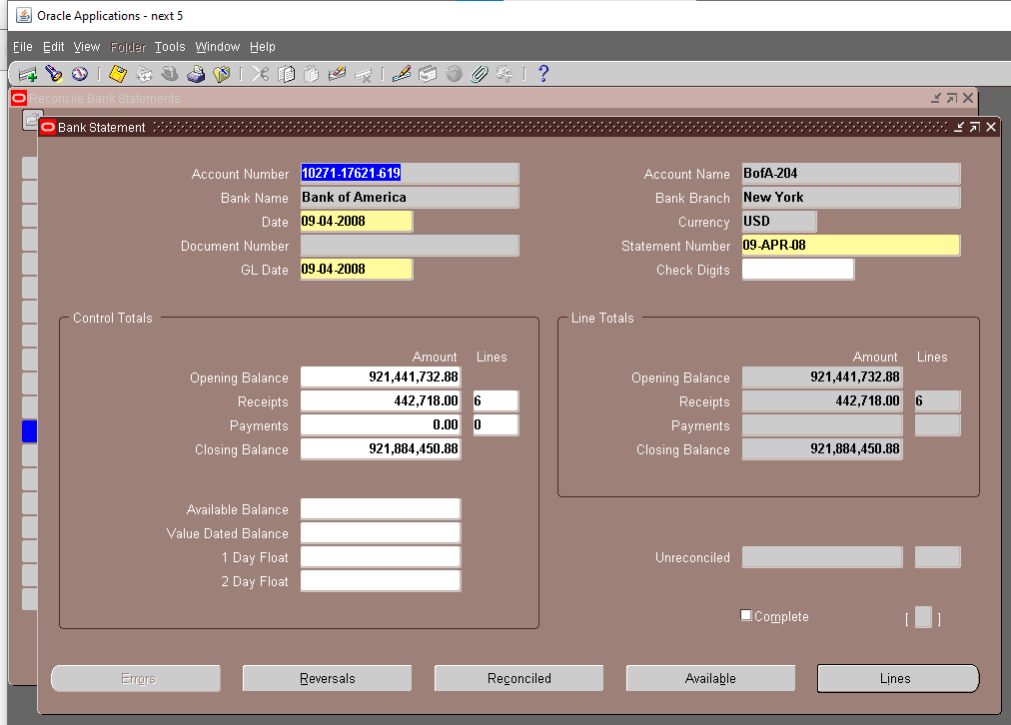
Bank statement window
Explain page content
Click line button

Slide 50
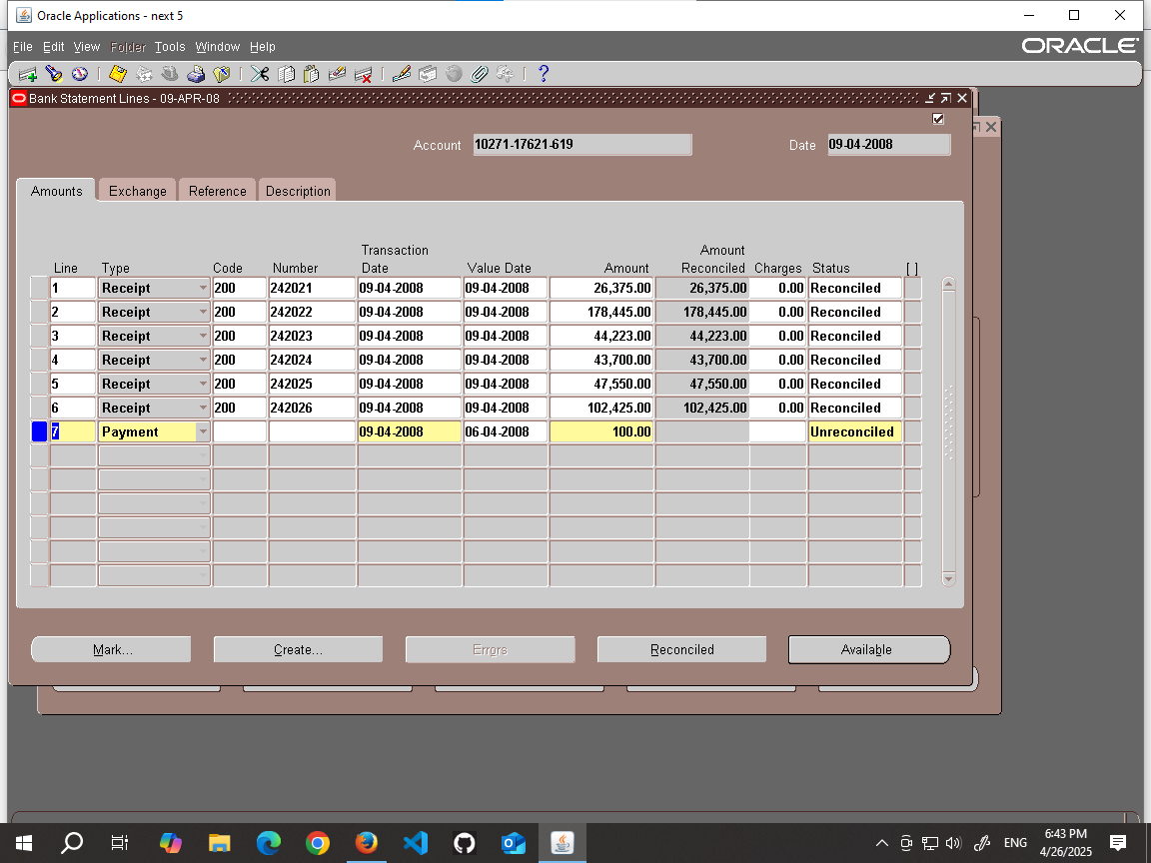
Bank statement line window
Explain page contents
Click Available button

Slide 52
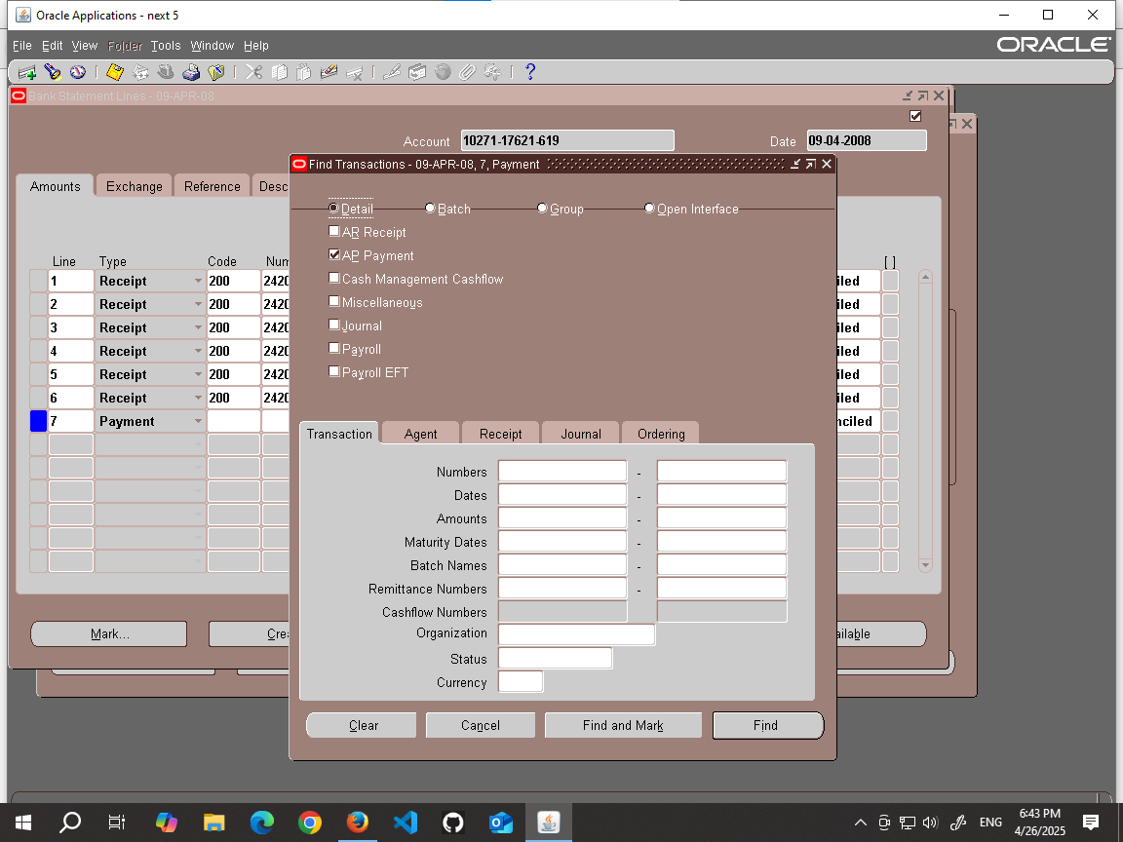
Available transaction window
Explain page contents
Click the reconciled button

Slide 53
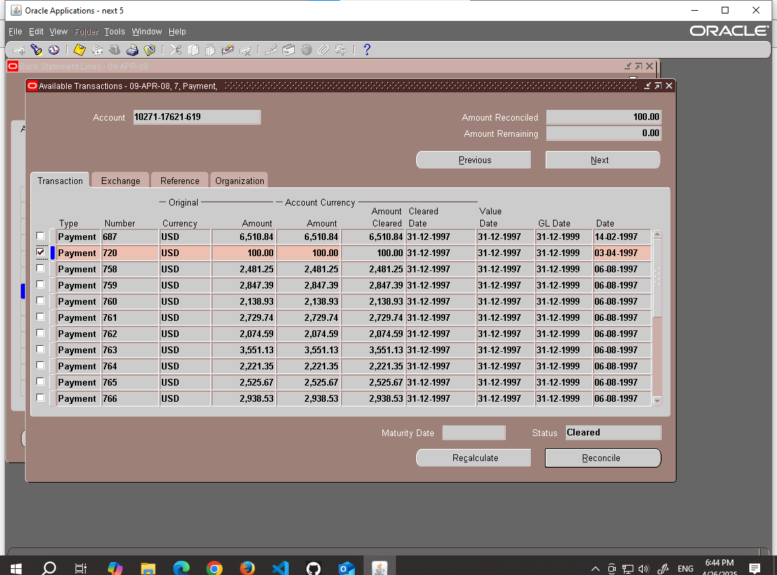

Slide 54
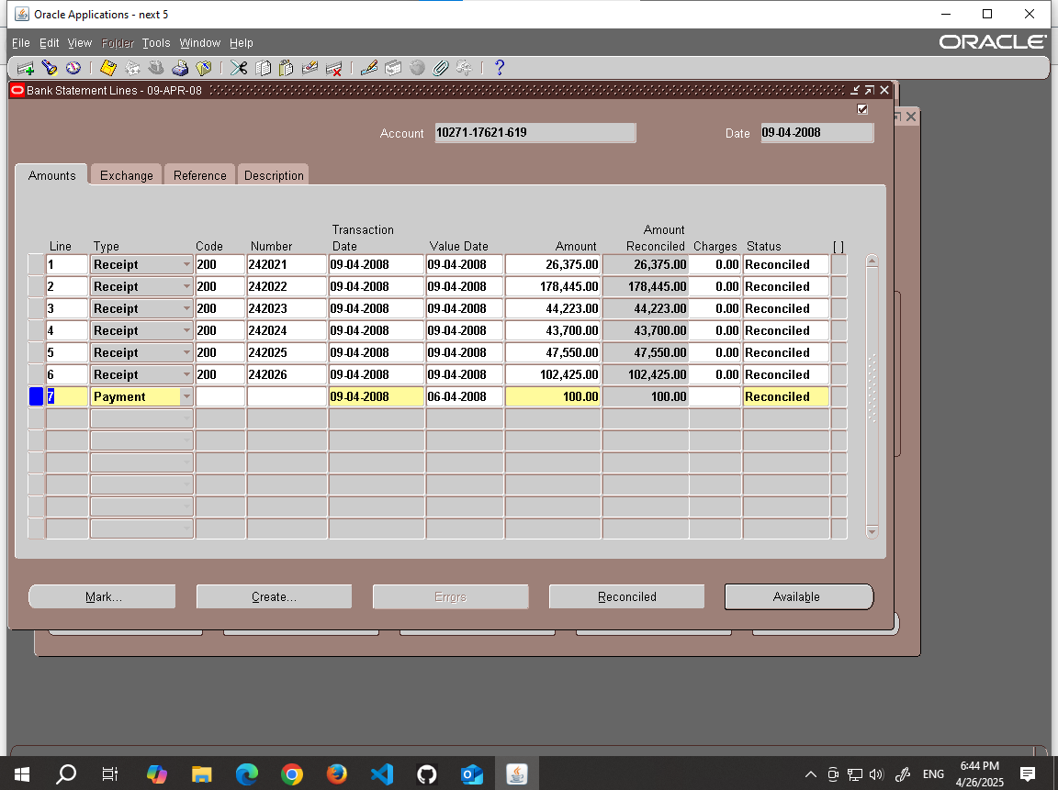
Bank statement line window
NOTICE

Slide 56
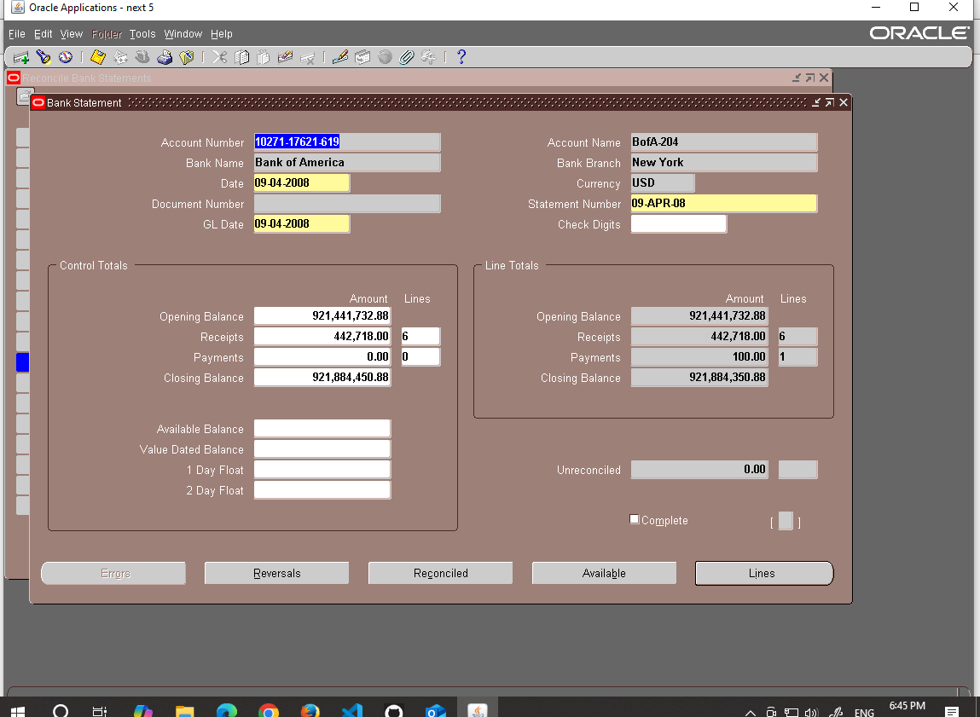
Bank statement window
NOTICE
Click complete button

Slide 57
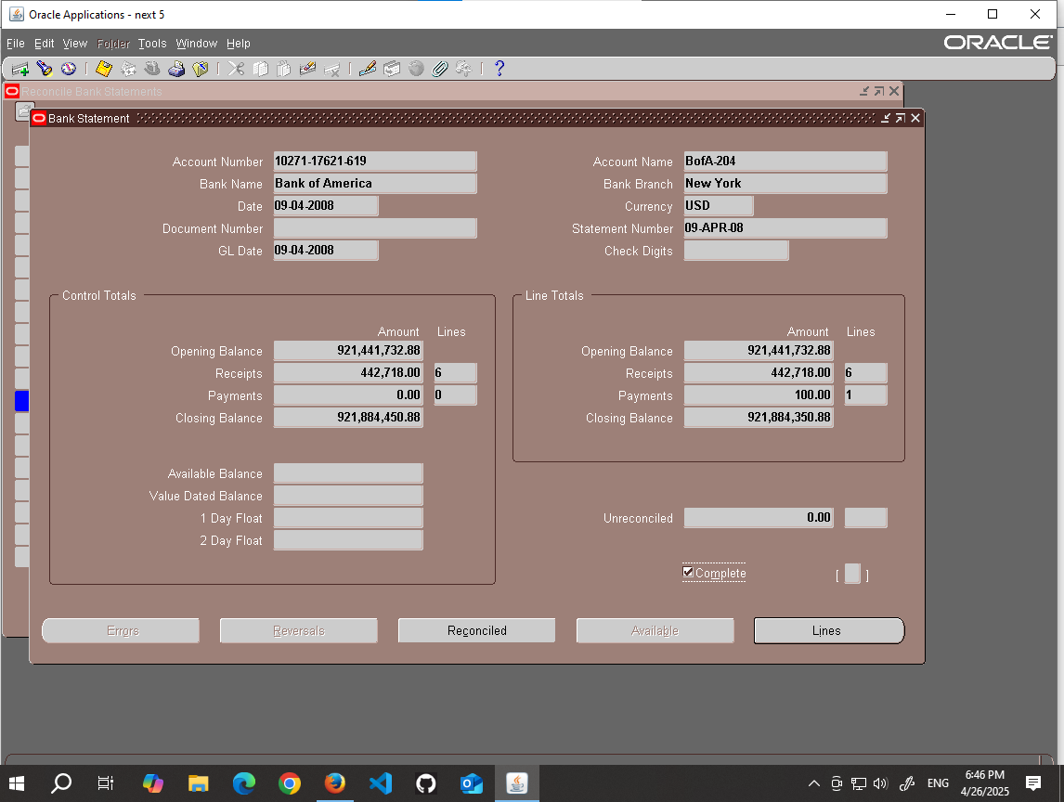

Slide 58

Cash Forecasting
Presented By :Moataz Emad Eldin Hassan

Slide 59
Introduction
What is Cash Forecasting?
It assists in evaluating a company's liquidity position and making informed financial decisions.
A planning tool that helps predict cash inflows and outflows.
Assists in assessing liquidity and determining future cash needs.
Relies on multiple sources such as invoices, payments, purchase, and sales orders.

Slide 60
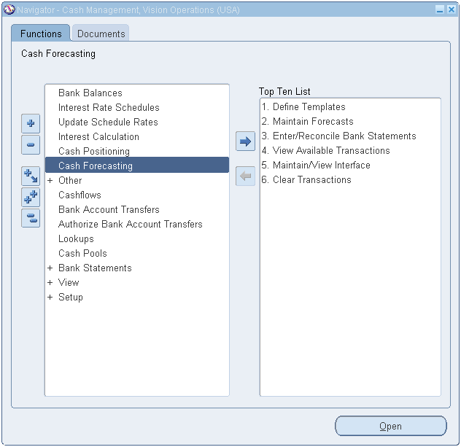
Steps to Set Up Cash Forecasting
2. Navigating to Cash Management Module
Switch responsibility to: Cash Management, Vision Operations (USA)
Go to: Cash Forecasting

Slide 61
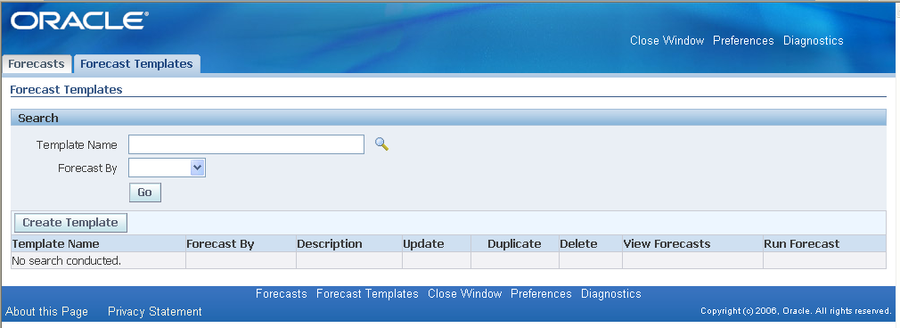
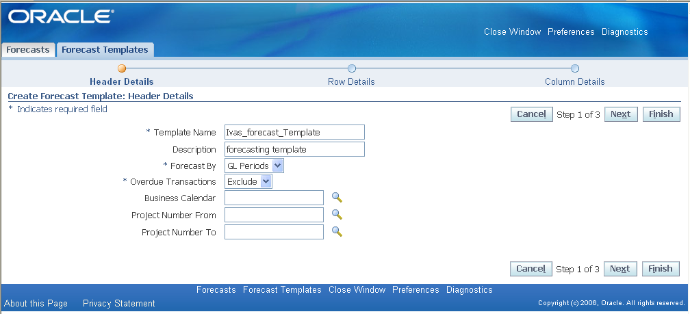
Creating a Cash Forecasting Template
Click "Create New Template."
Enter template name: Ivas_forecast_Template.
Select "Forecast By" as "GL Periods."
Exclude overdue transactions.
Click "Next."

Slide 62
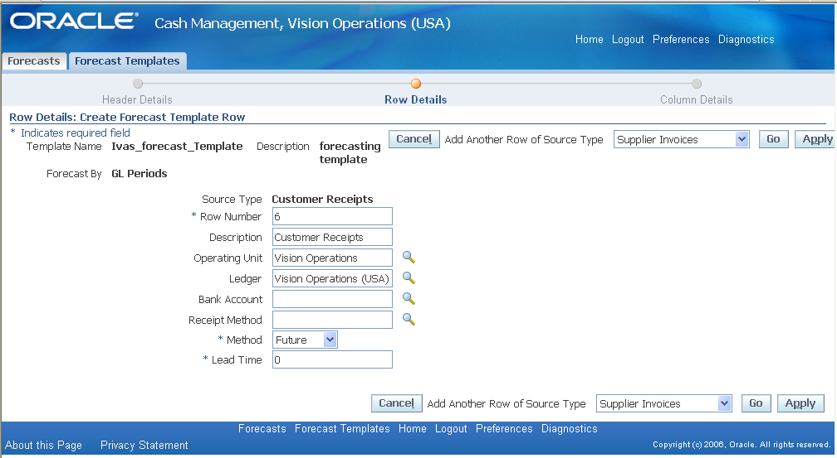
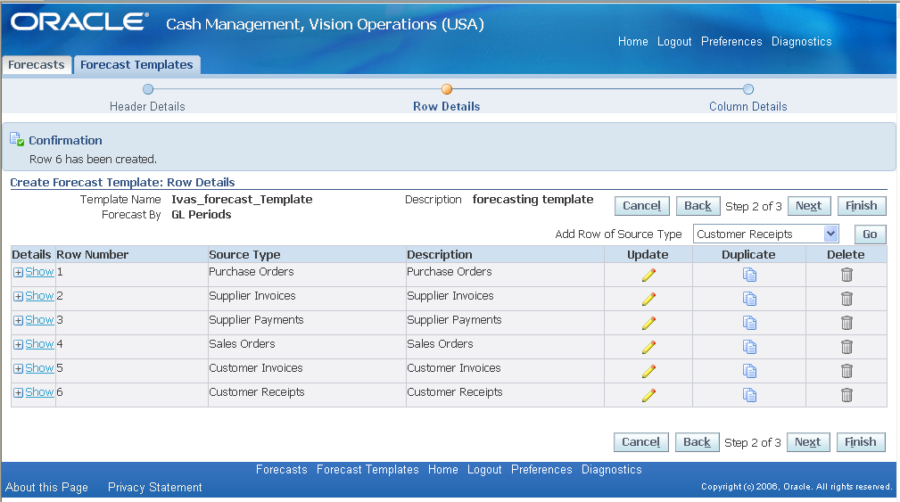
Adding Data Sources
Included Sources:
Purchase Orders
Supplier Invoices
Supplier Payments
Sales Orders
Customer Invoices
Customer Receipts
Entry Method:
Select source type and enter required data.
Click "Apply" for each source.

Slide 63
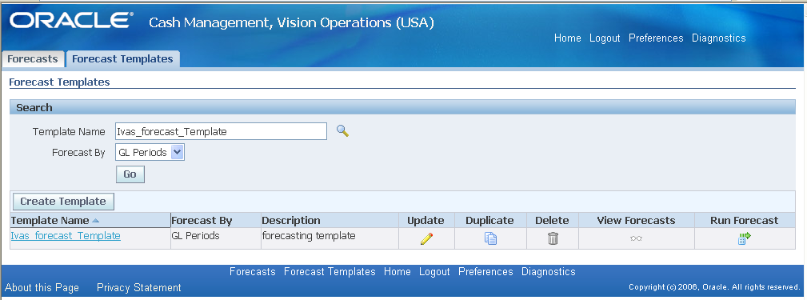

Running the Forecast and Viewing Results
1. Running the Forecast
Click "View Forecast."
Enter required data and "Submit."
Select template: Ivas_forecast_Template.
Click "Run Forecast.“

Slide 64


2. Viewing Results
Navigate To Menu > View > Requests.
Click "Find" Then "Refresh Data."
View Final Output.

Slide 65


Final Report Overview
Key Components of the Final Report:
Summary of cash inflows and outflows.
Forecast accuracy metrics.
Comparison of projected vs. actual cash positions.
Breakdown by sources (Invoices, Payments, Orders).
Actionable Insights:
Identify liquidity risks and optimization opportunities.
Adjust forecasting parameters based on performance.
Review currency fluctuations and their impact.

